Slide 1
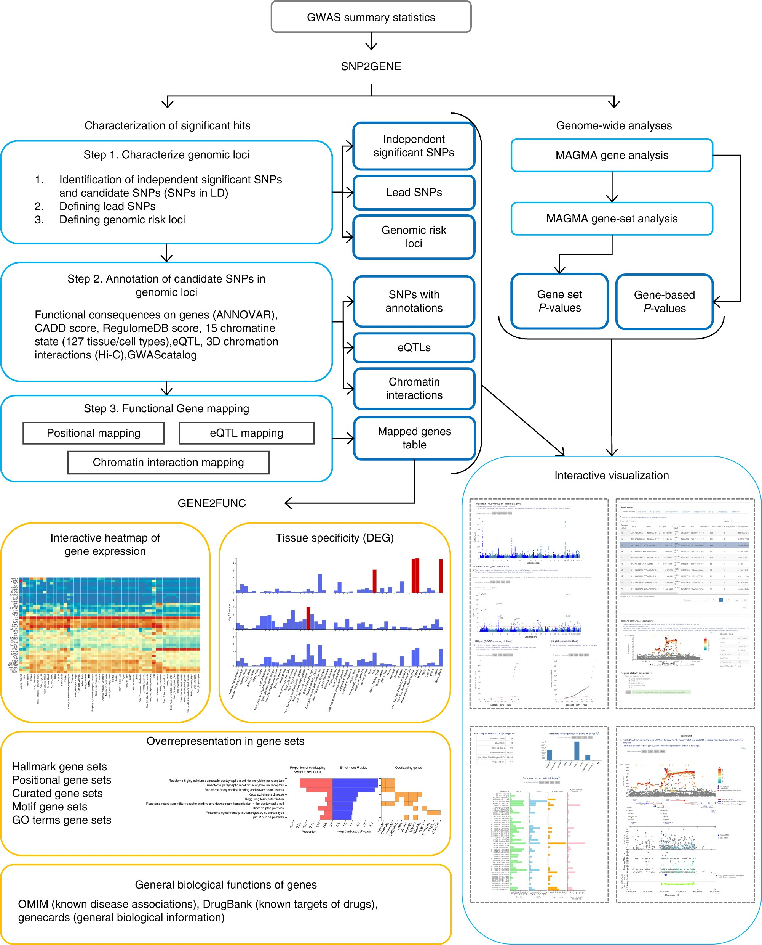
3MR: DED, DEP, and IBS
FUMA (doi: 10.1038/s41467-017-01261-5)
GWAS vs. MTAG for one-sample MR

Slide 2
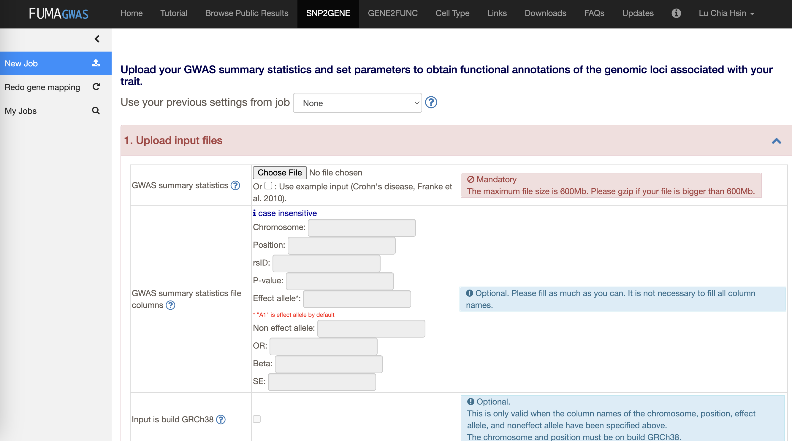
- significant level
- reference panel
*currently disabled

Slide 3
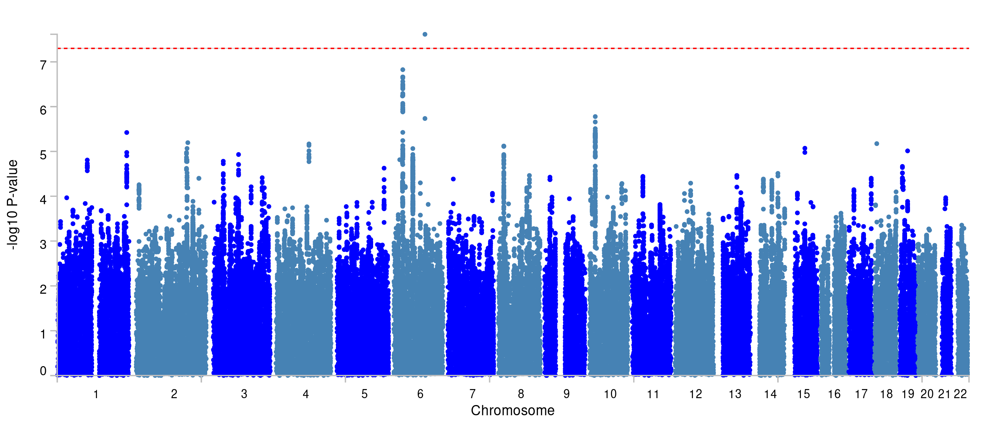
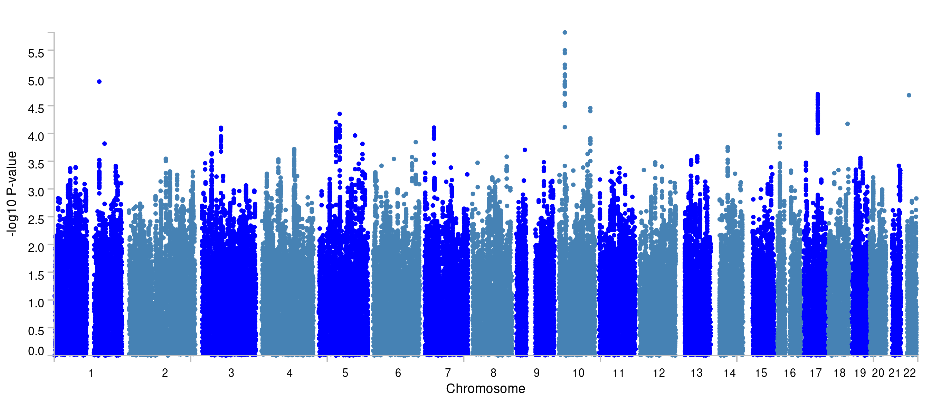
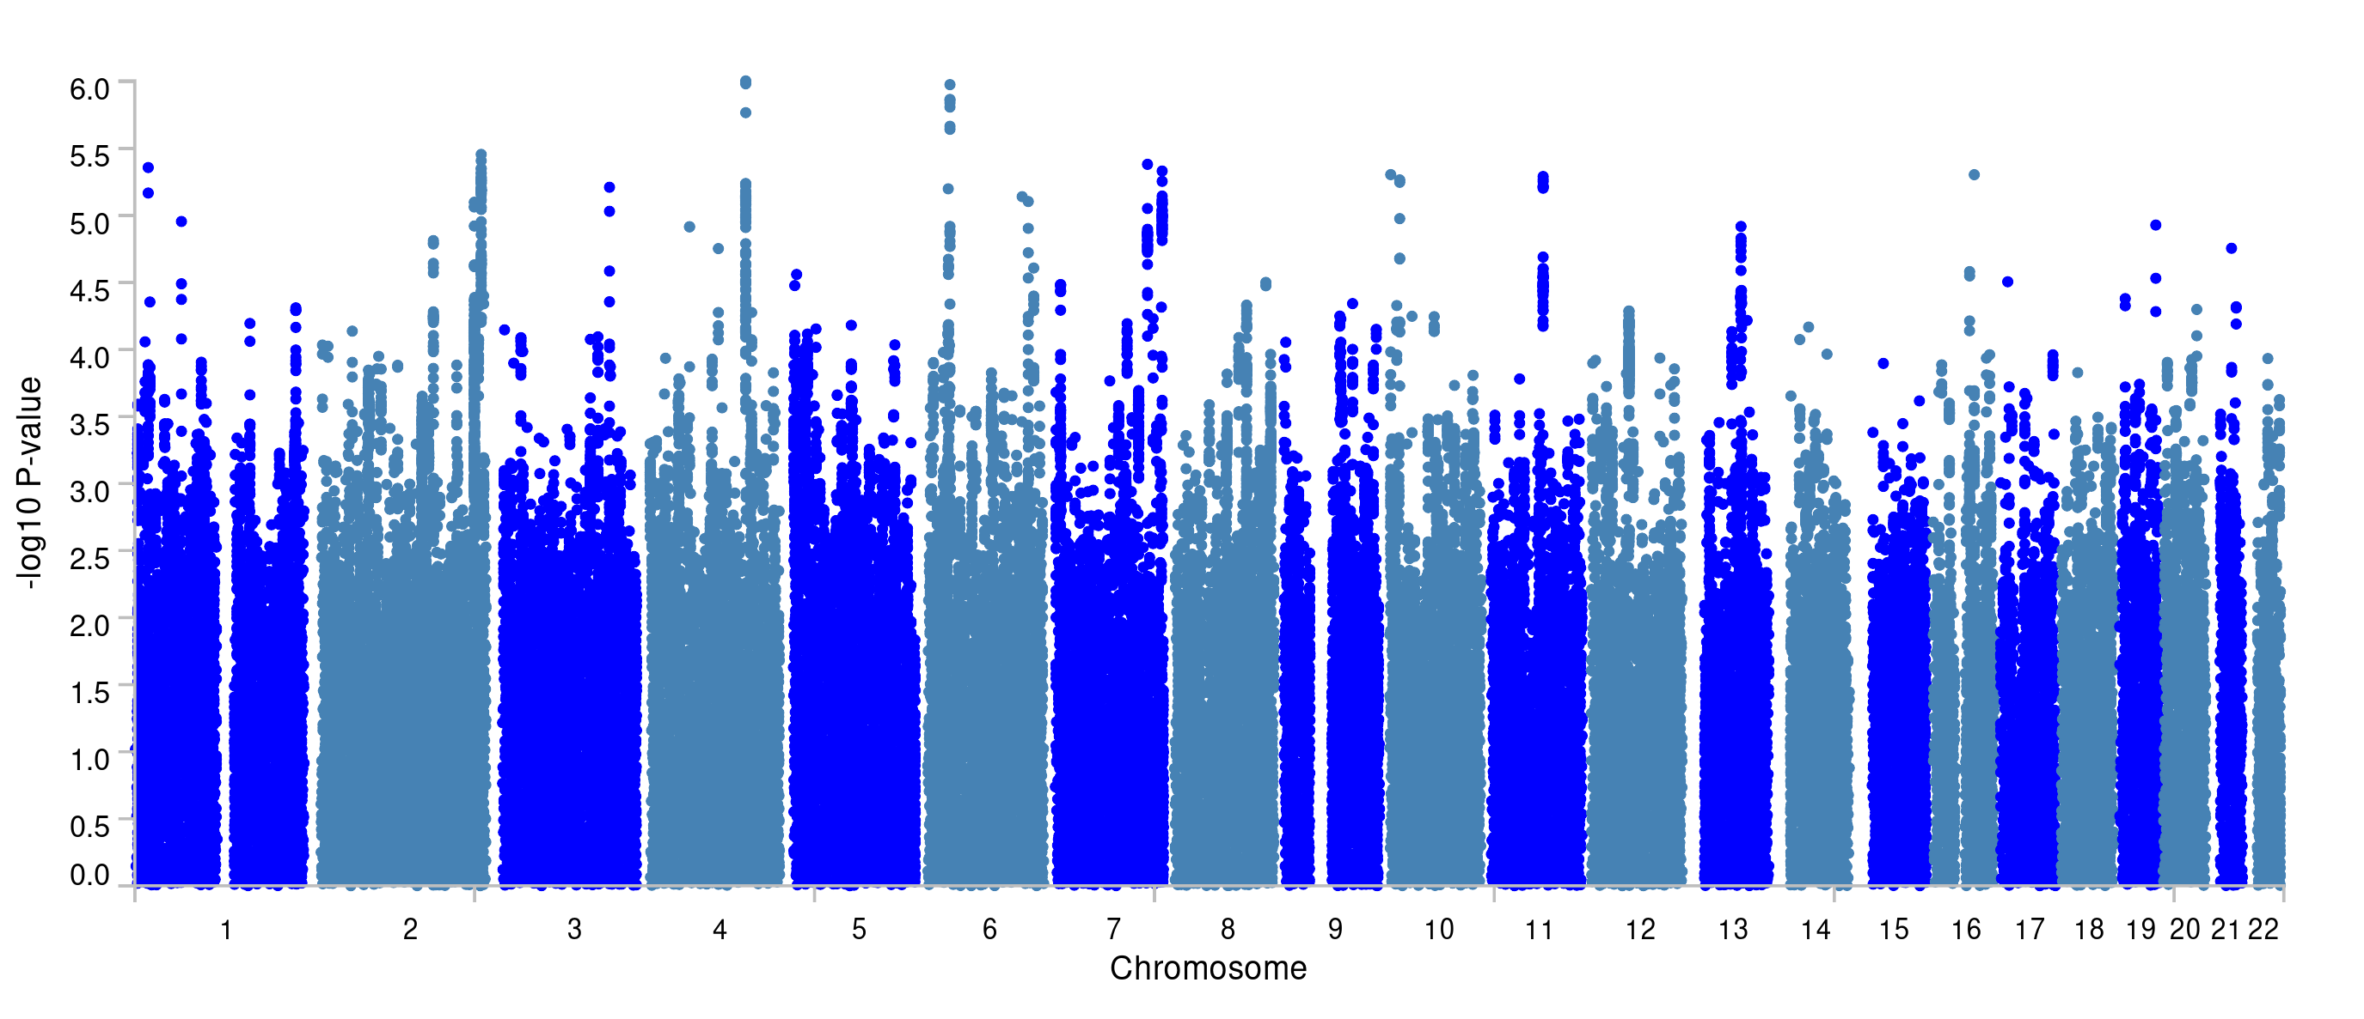
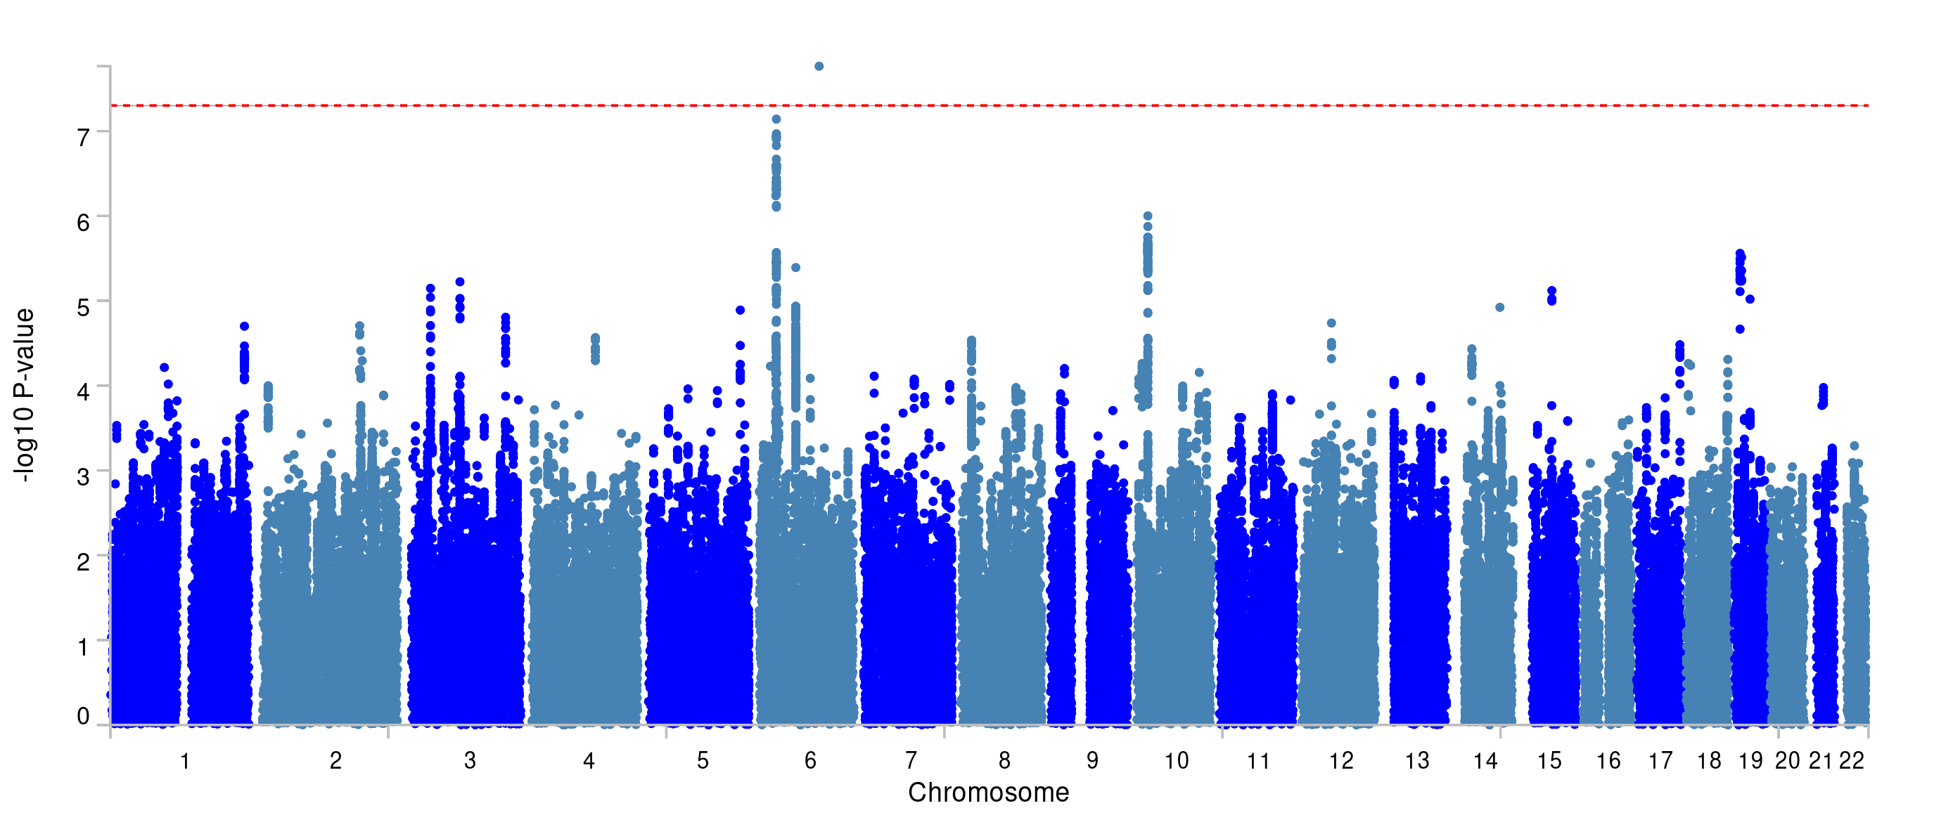
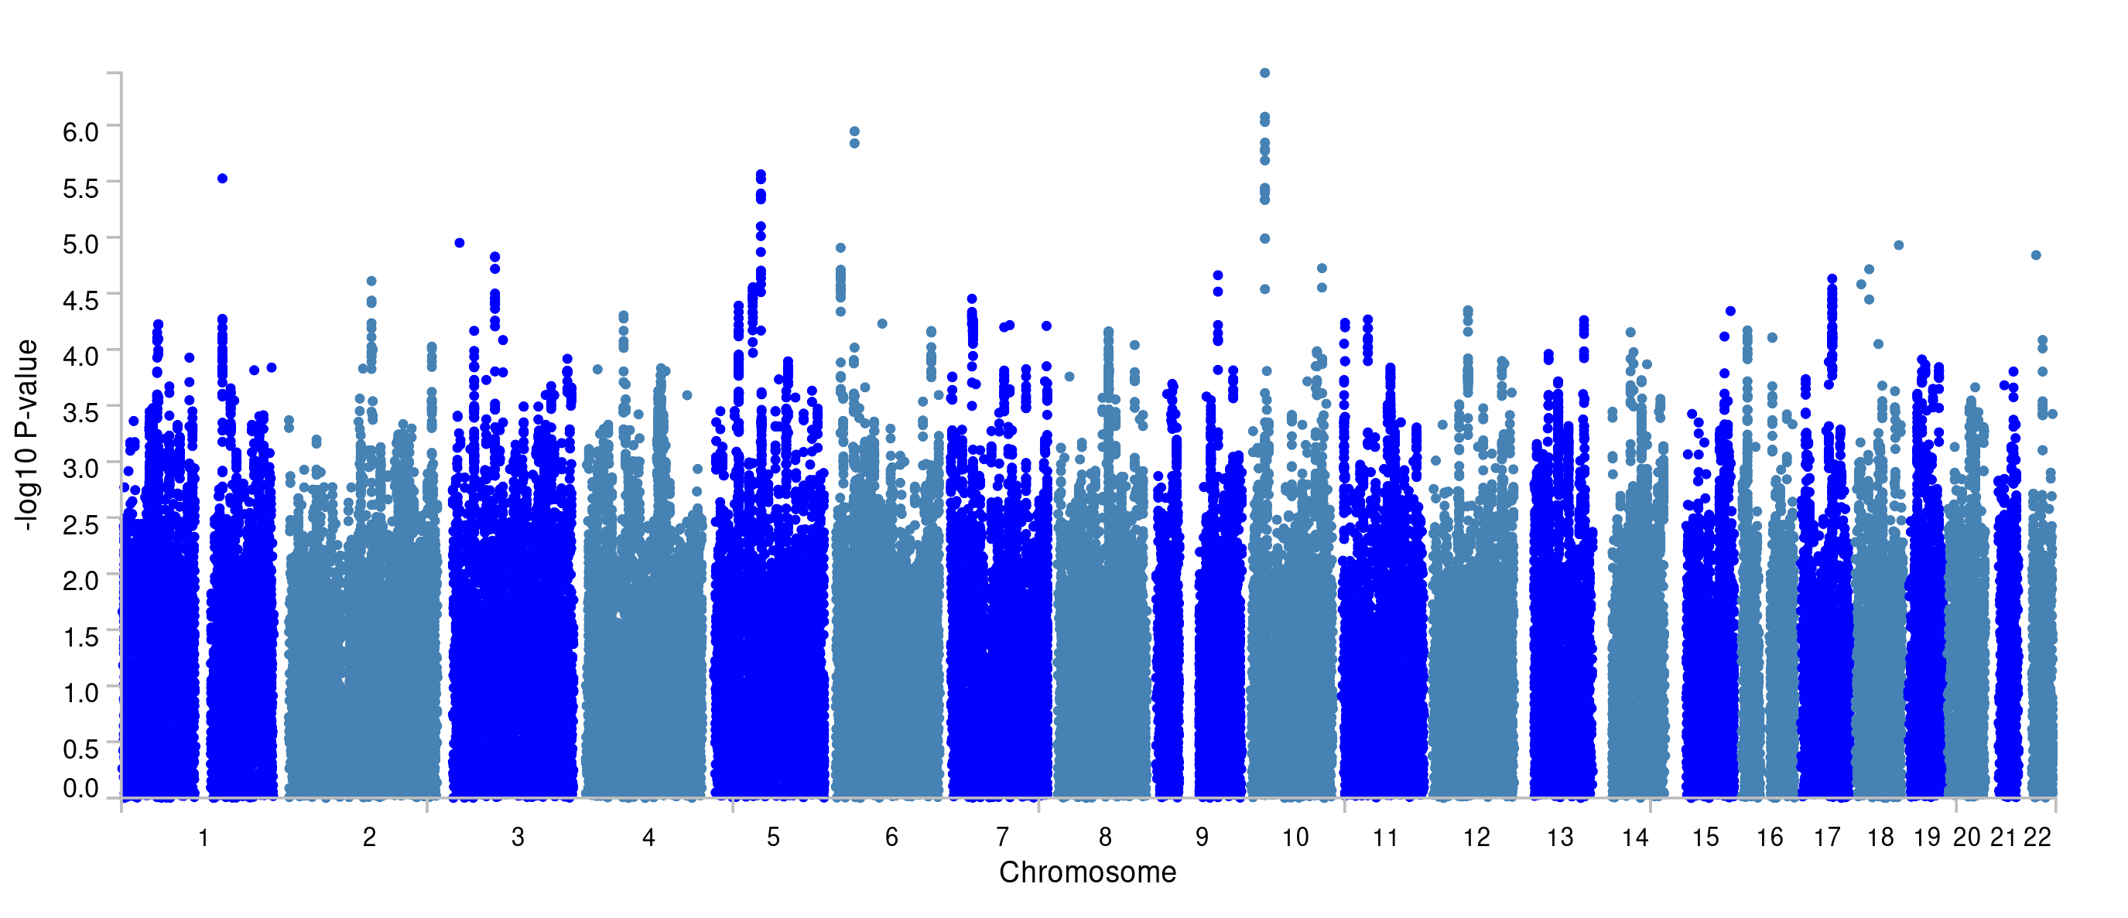
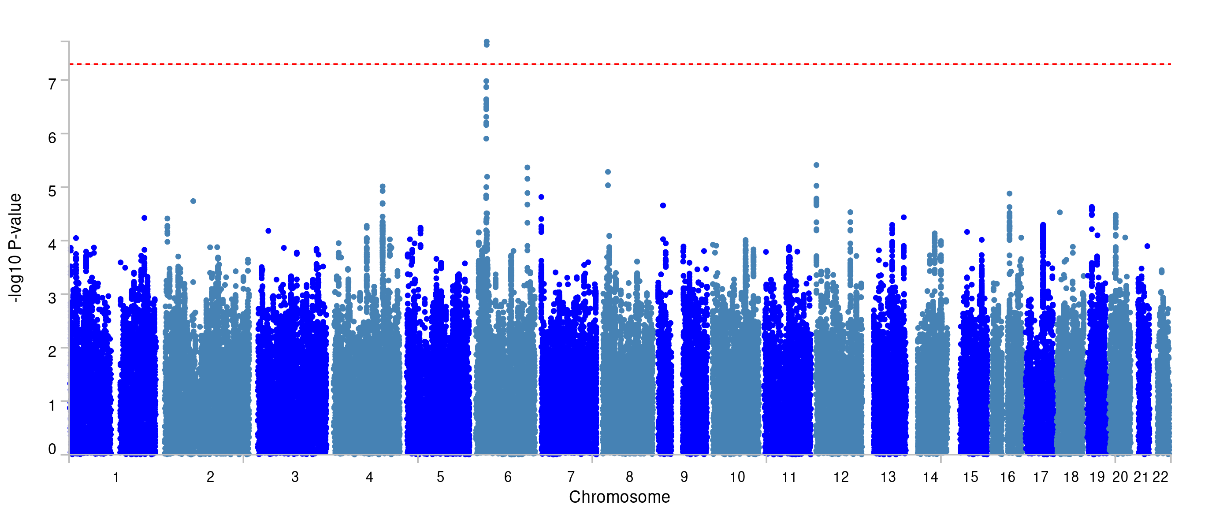
Manhattan plots
IBS
DED
DEP
GWAS
MTAG
*red line represents p<5e-8

Slide 4
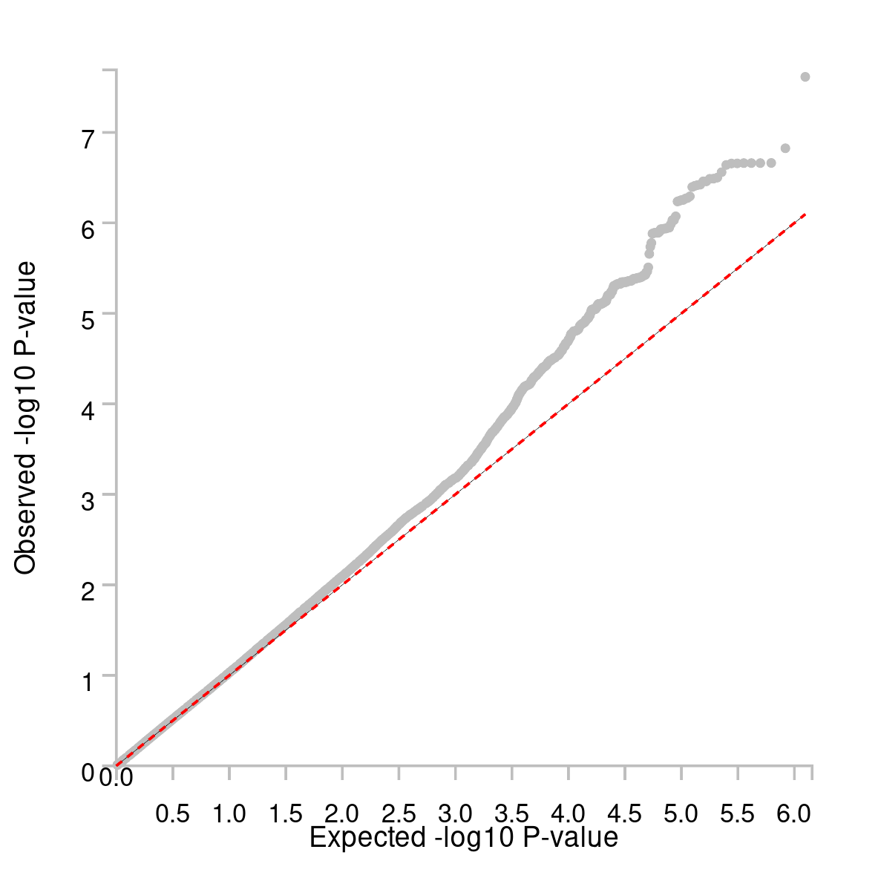
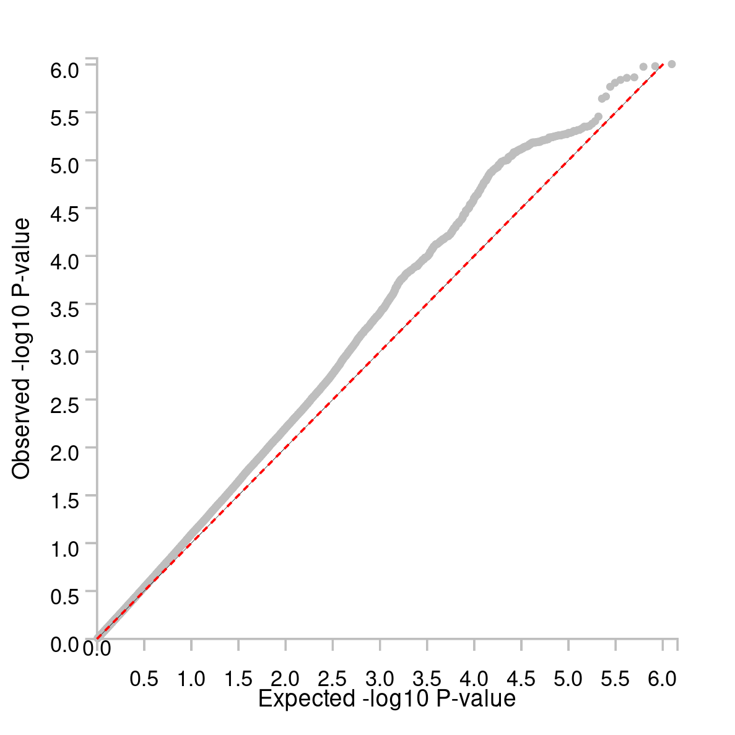
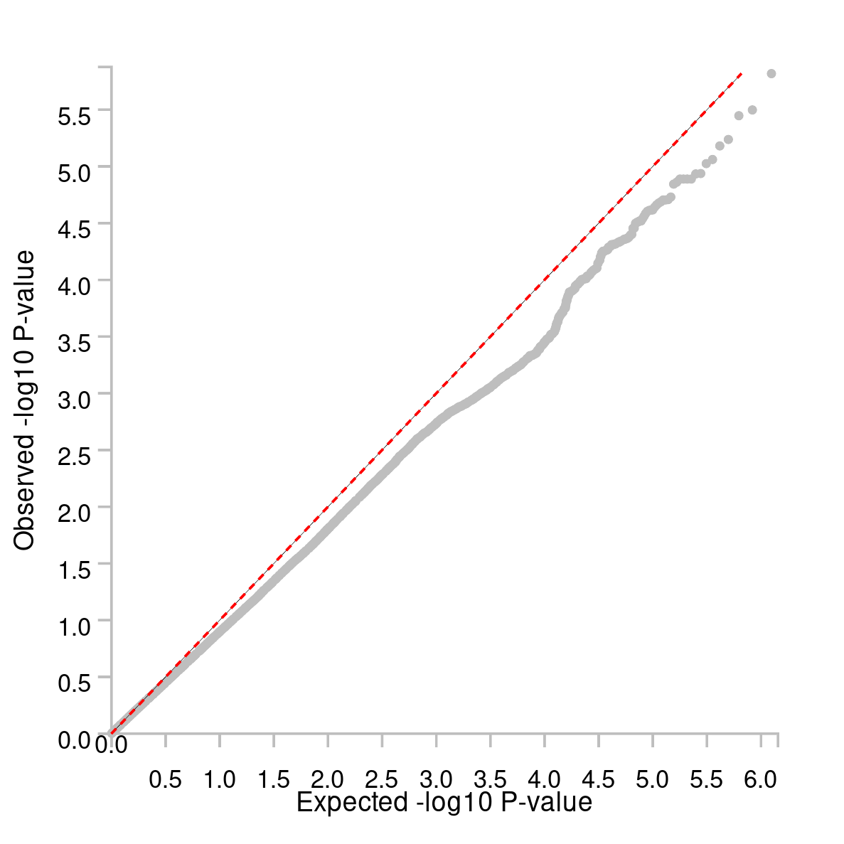
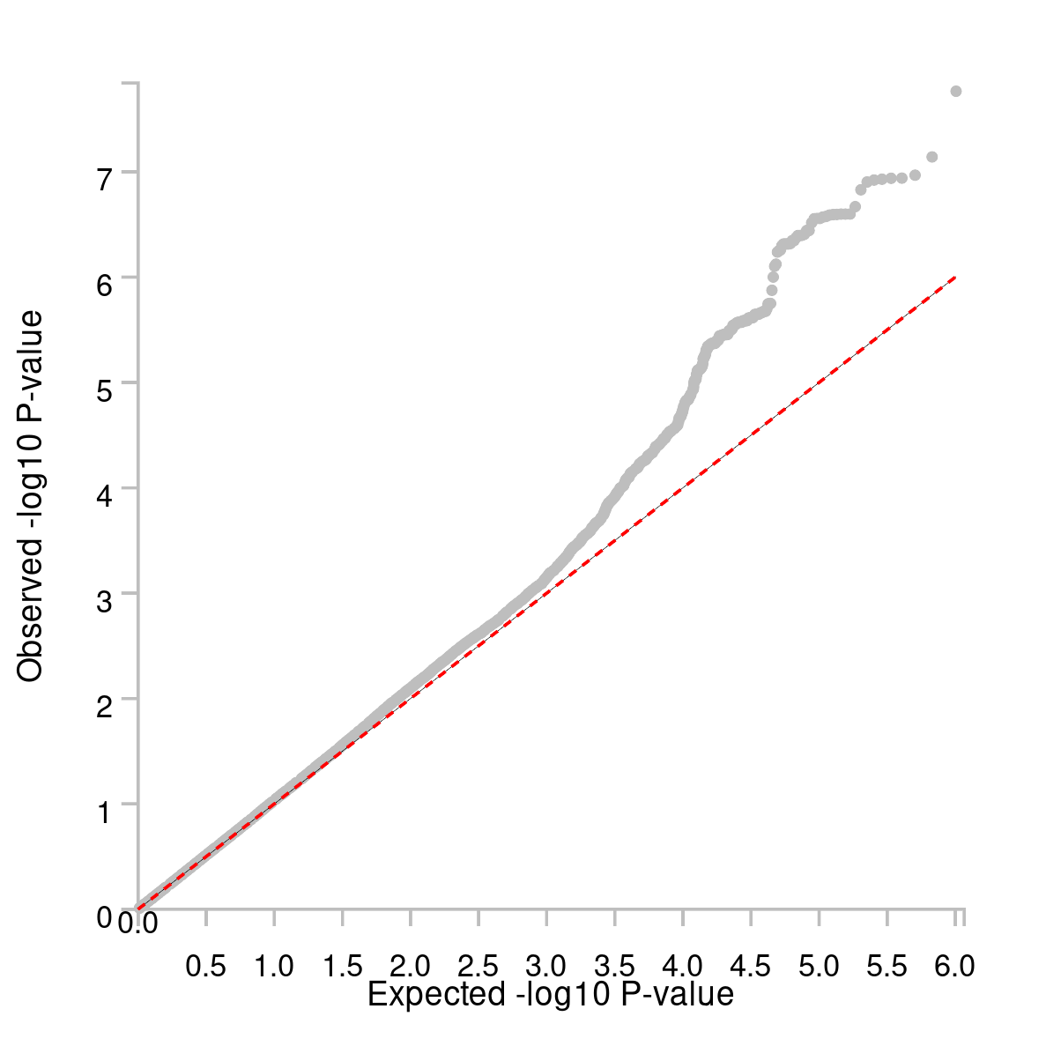
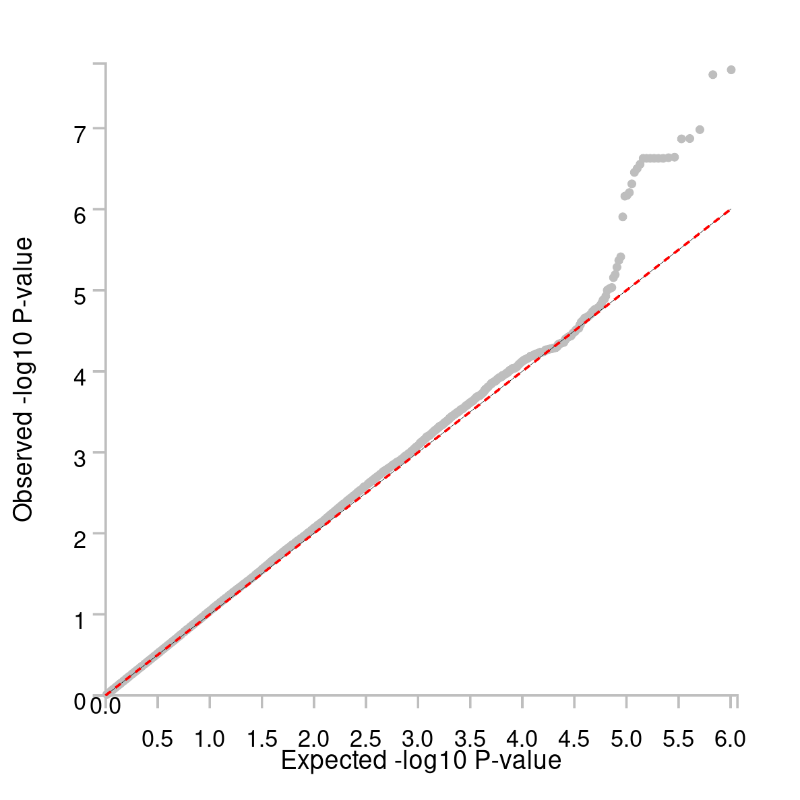
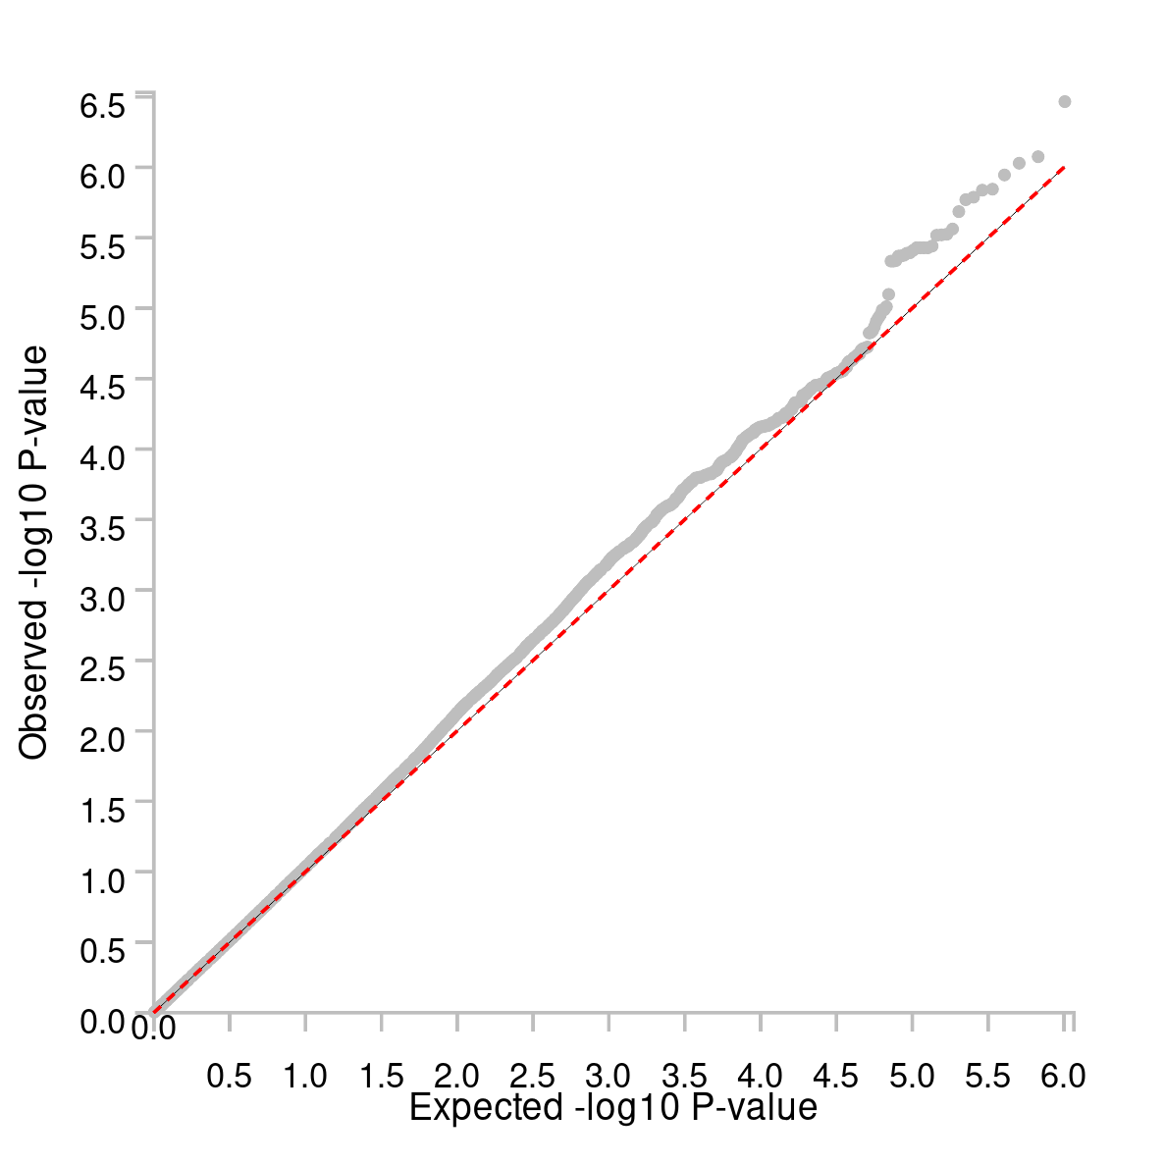
Q-Q plots
IBS
DED
DEP
GWAS
MTAG

Slide 5
SNP2GENE
r^2 < 0.6 defined as a LD block
IndSigSNP = p<1e-5 within each LD block
candidate SNPs = in LD with IndSigSNP
genomic risk loci marked by IndSigSNP
–
RegulomeDB categorical score (1a to 7)
GWAScatalog
CADD score (>12.37), pLI, ncRVIS
15 core chromatin state from ChromHMM
–
positional (maximum dist < 10 kb)
eQTL (FDR < 0.05)
chromatin interaction (FDR < 1e-6)

Slide 6
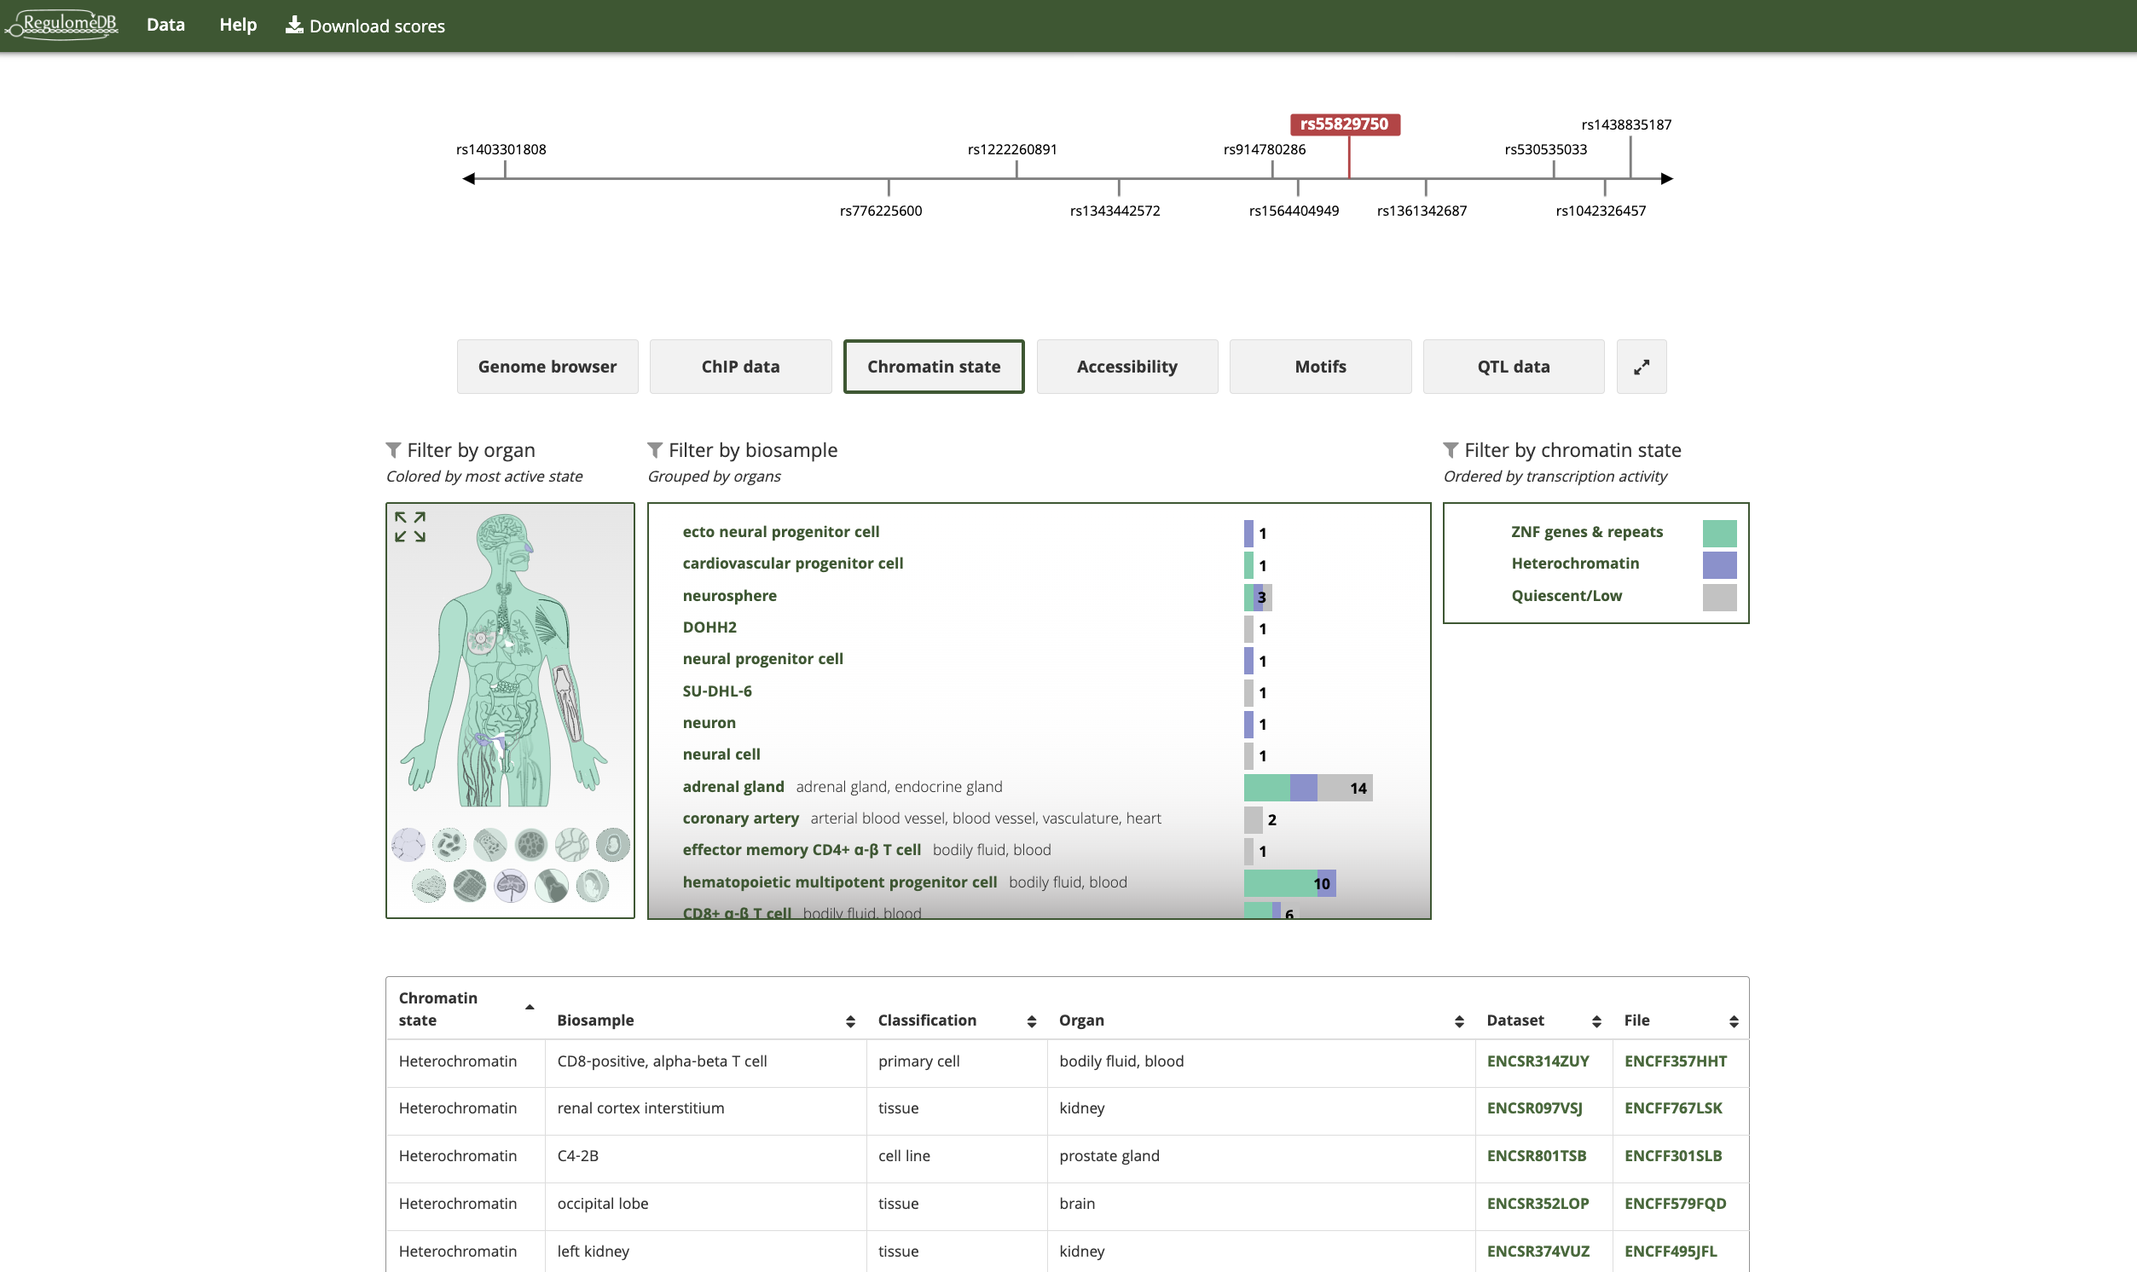

Slide 7
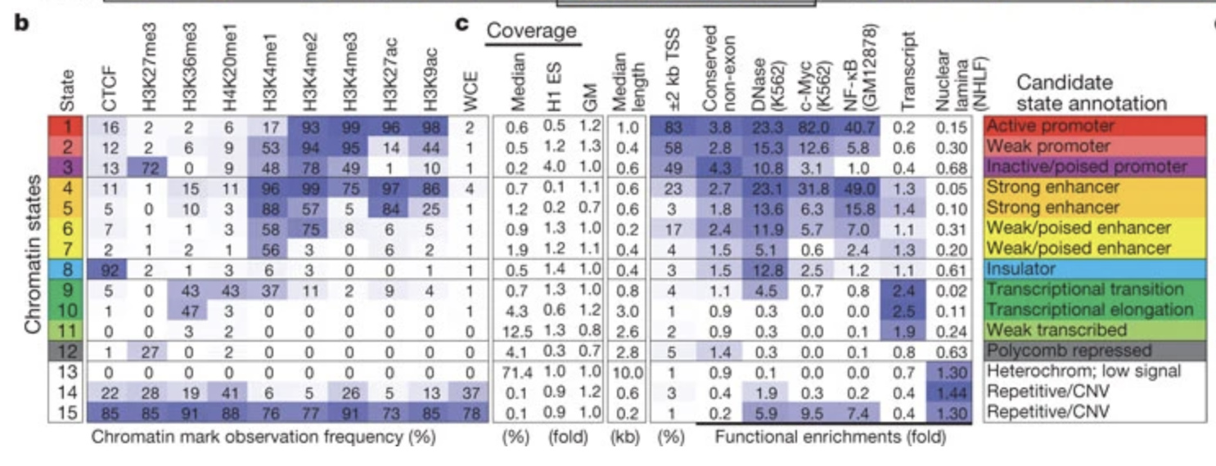
ChromHMM
Chip-seq data for 129 human cell and tissue types
American Type Culture Collection
*copy number variation, CNV (doi: 10.1038/nature09906)

Slide 8
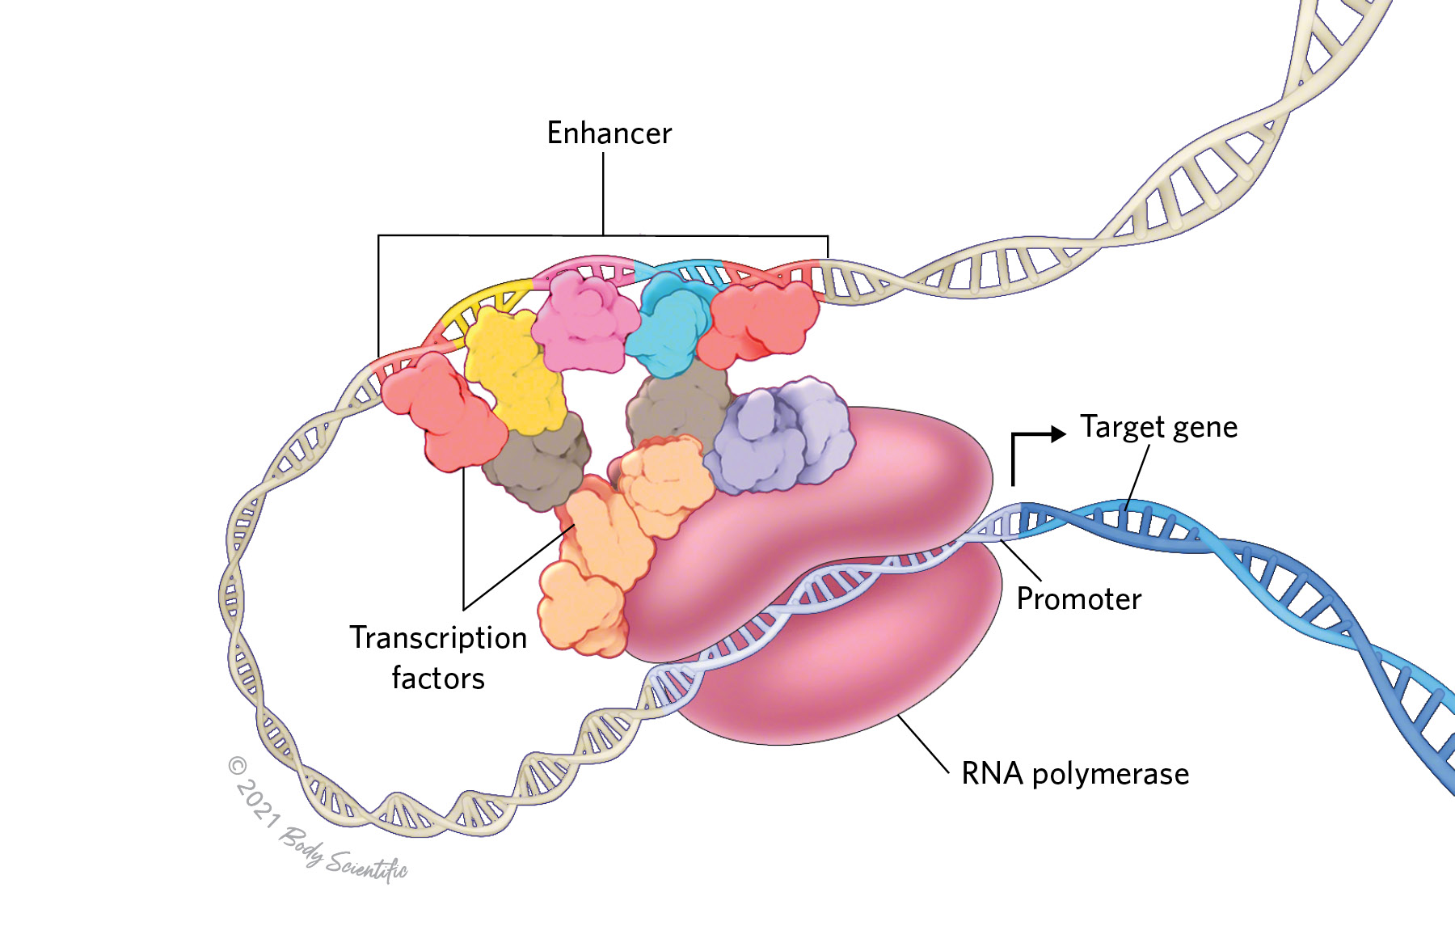
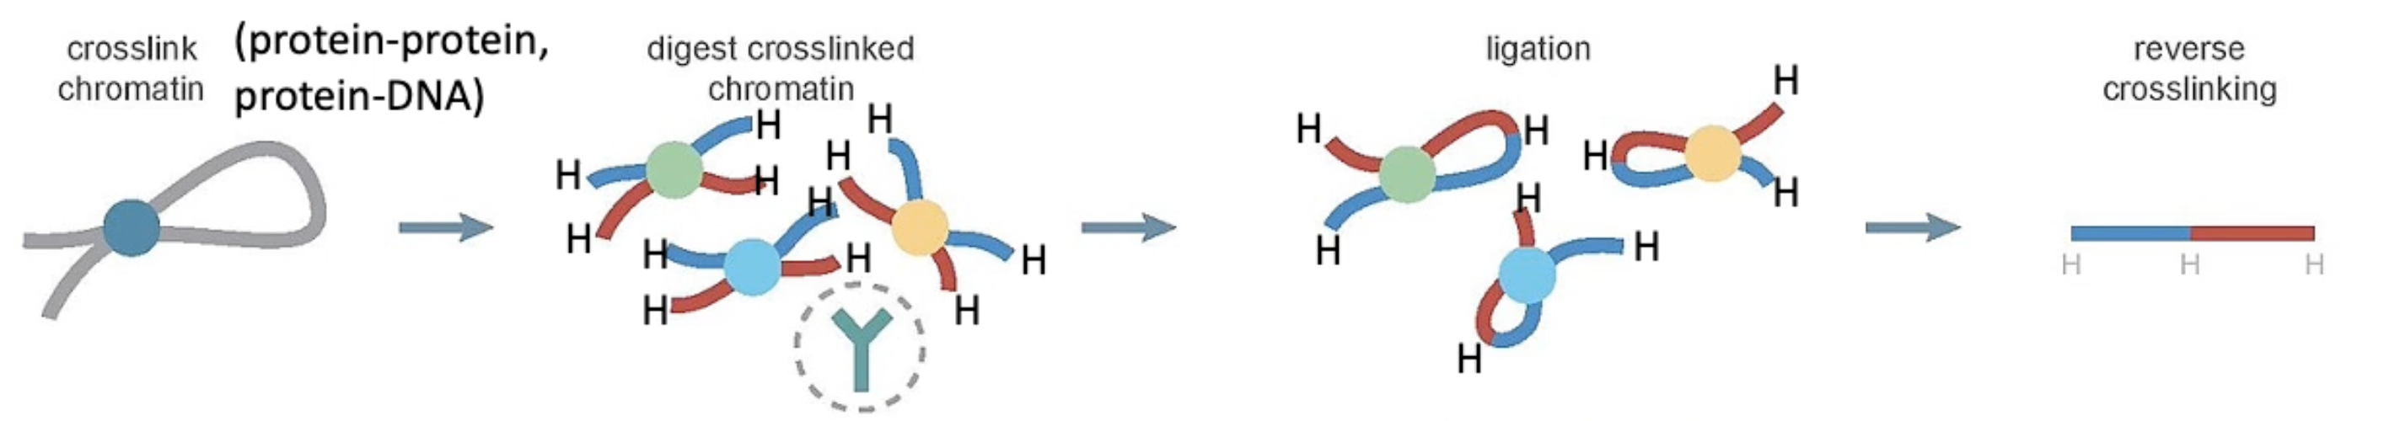
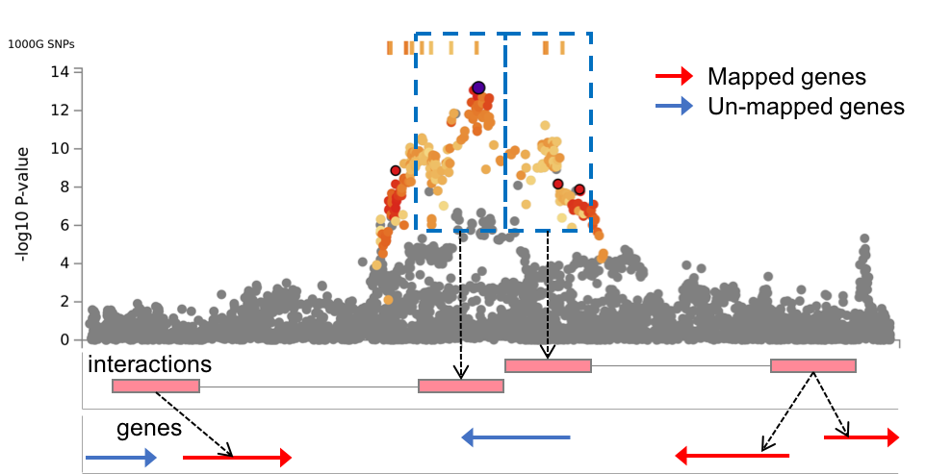
Chromatin Interaction mapping
chromatin conformation capture data, mostly Hi-C

Slide 9
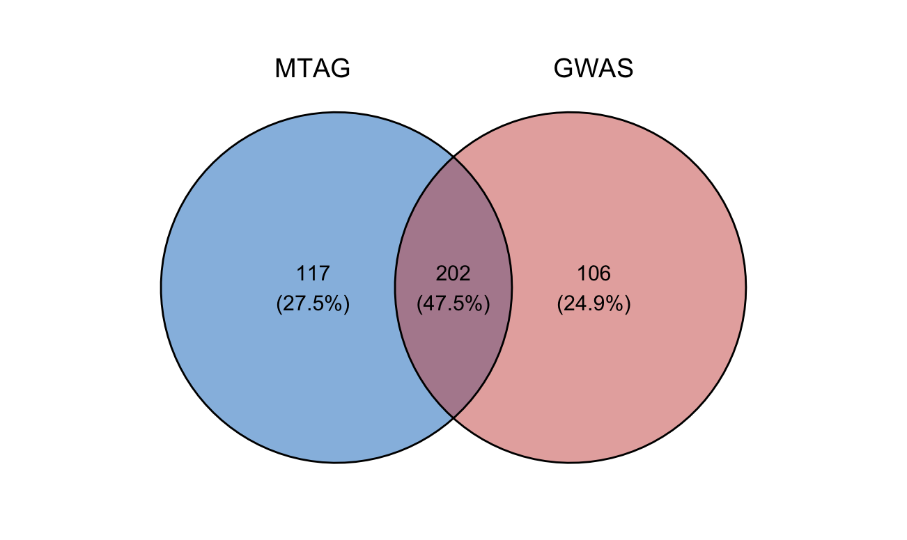
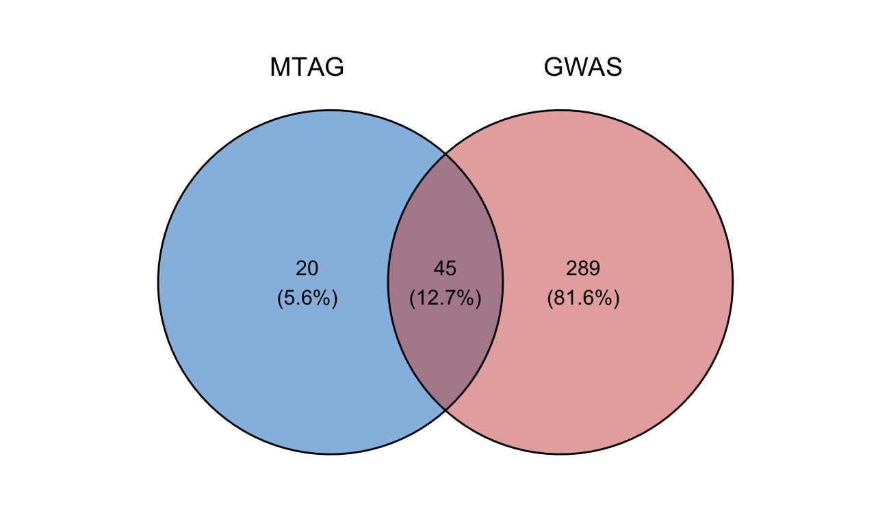
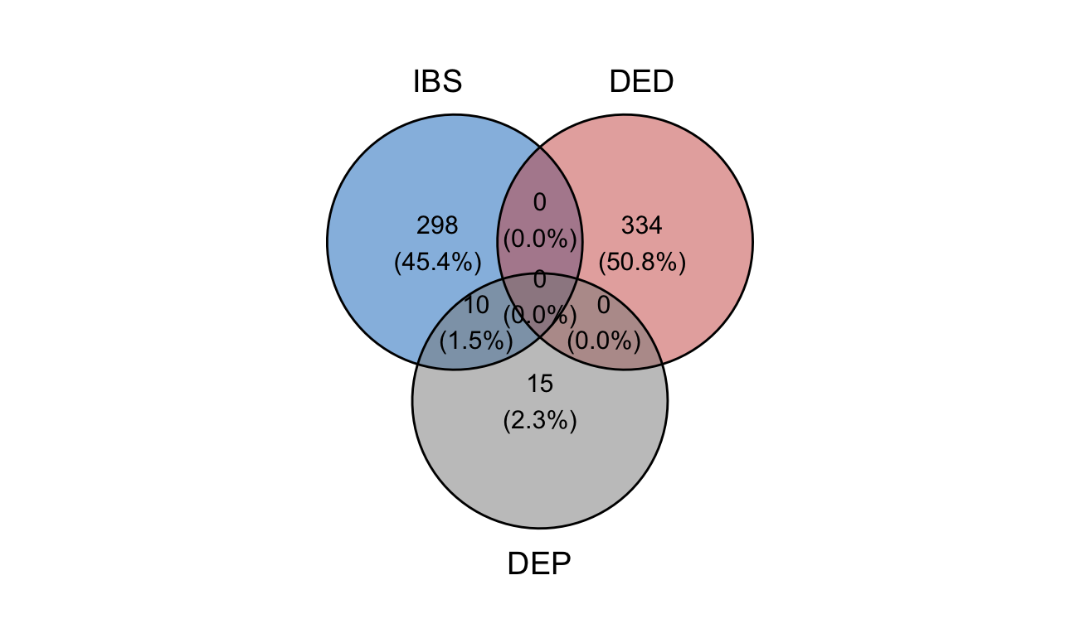
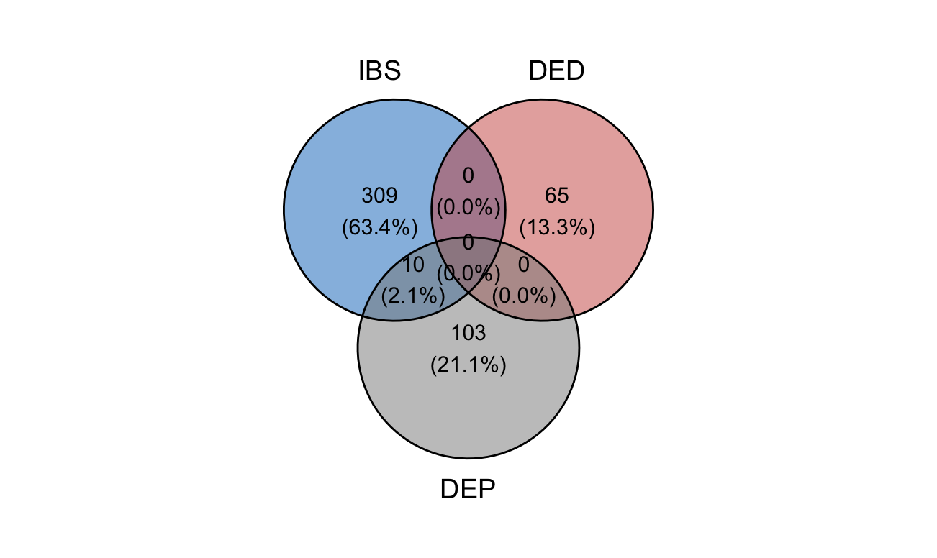

IBS
DED
GWAS
MTAG
DEP
*¹gene count include intergenic mappings *²almost no overlapping top 200 SNPs were found

Slide 10
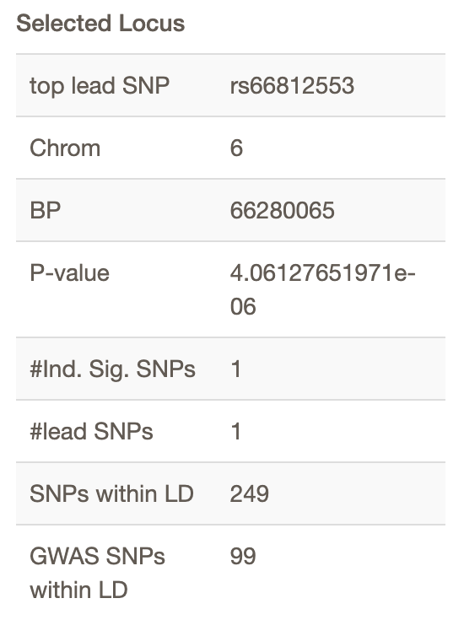
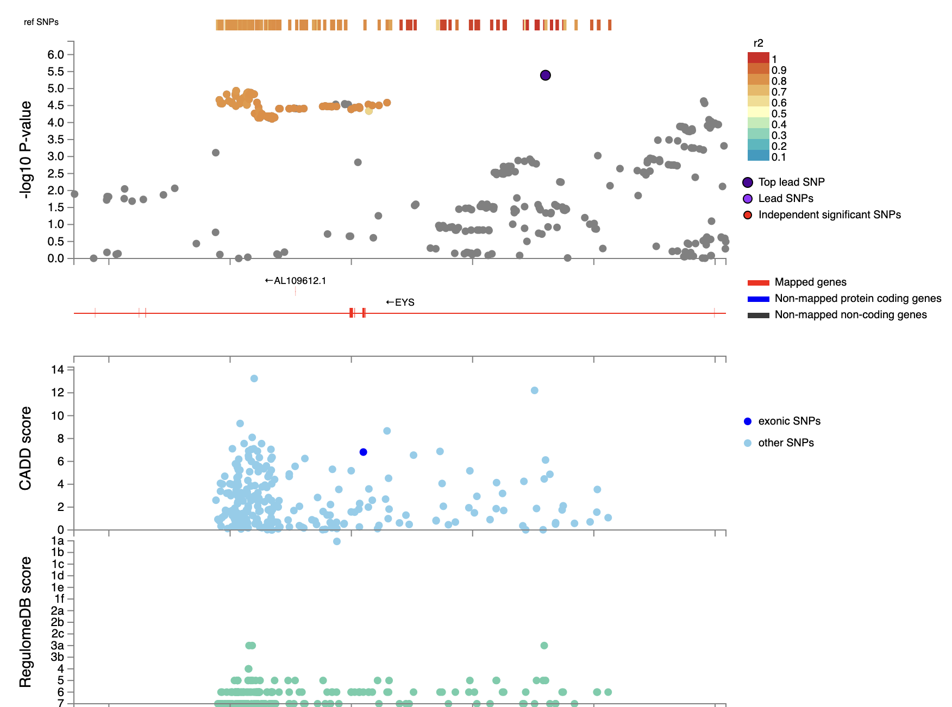
mapped to gene: EYS

Slide 11
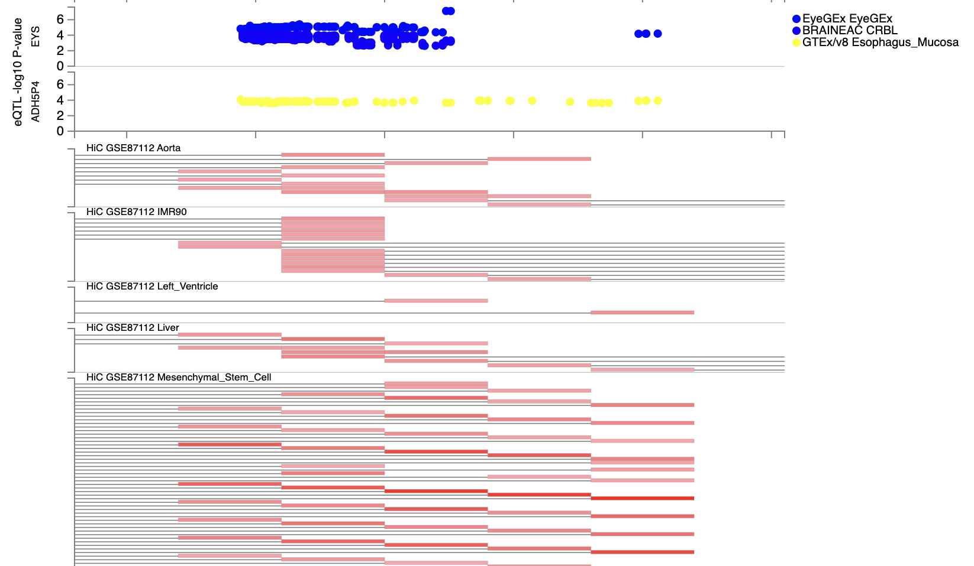

Slide 12
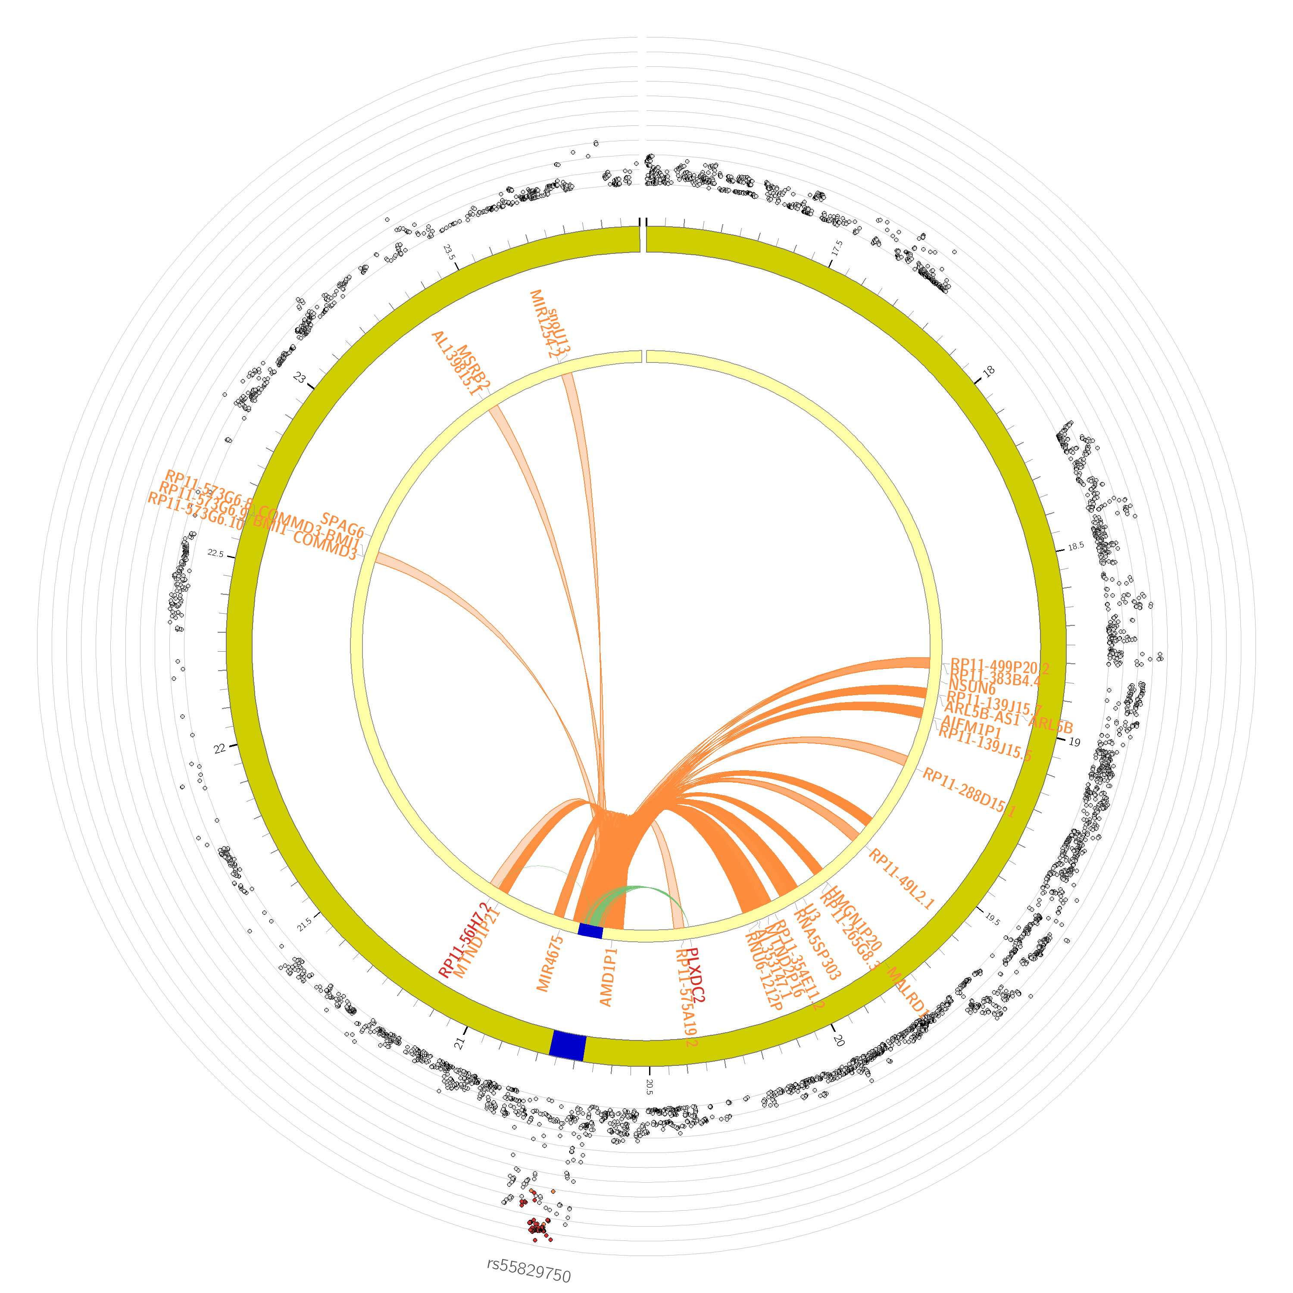
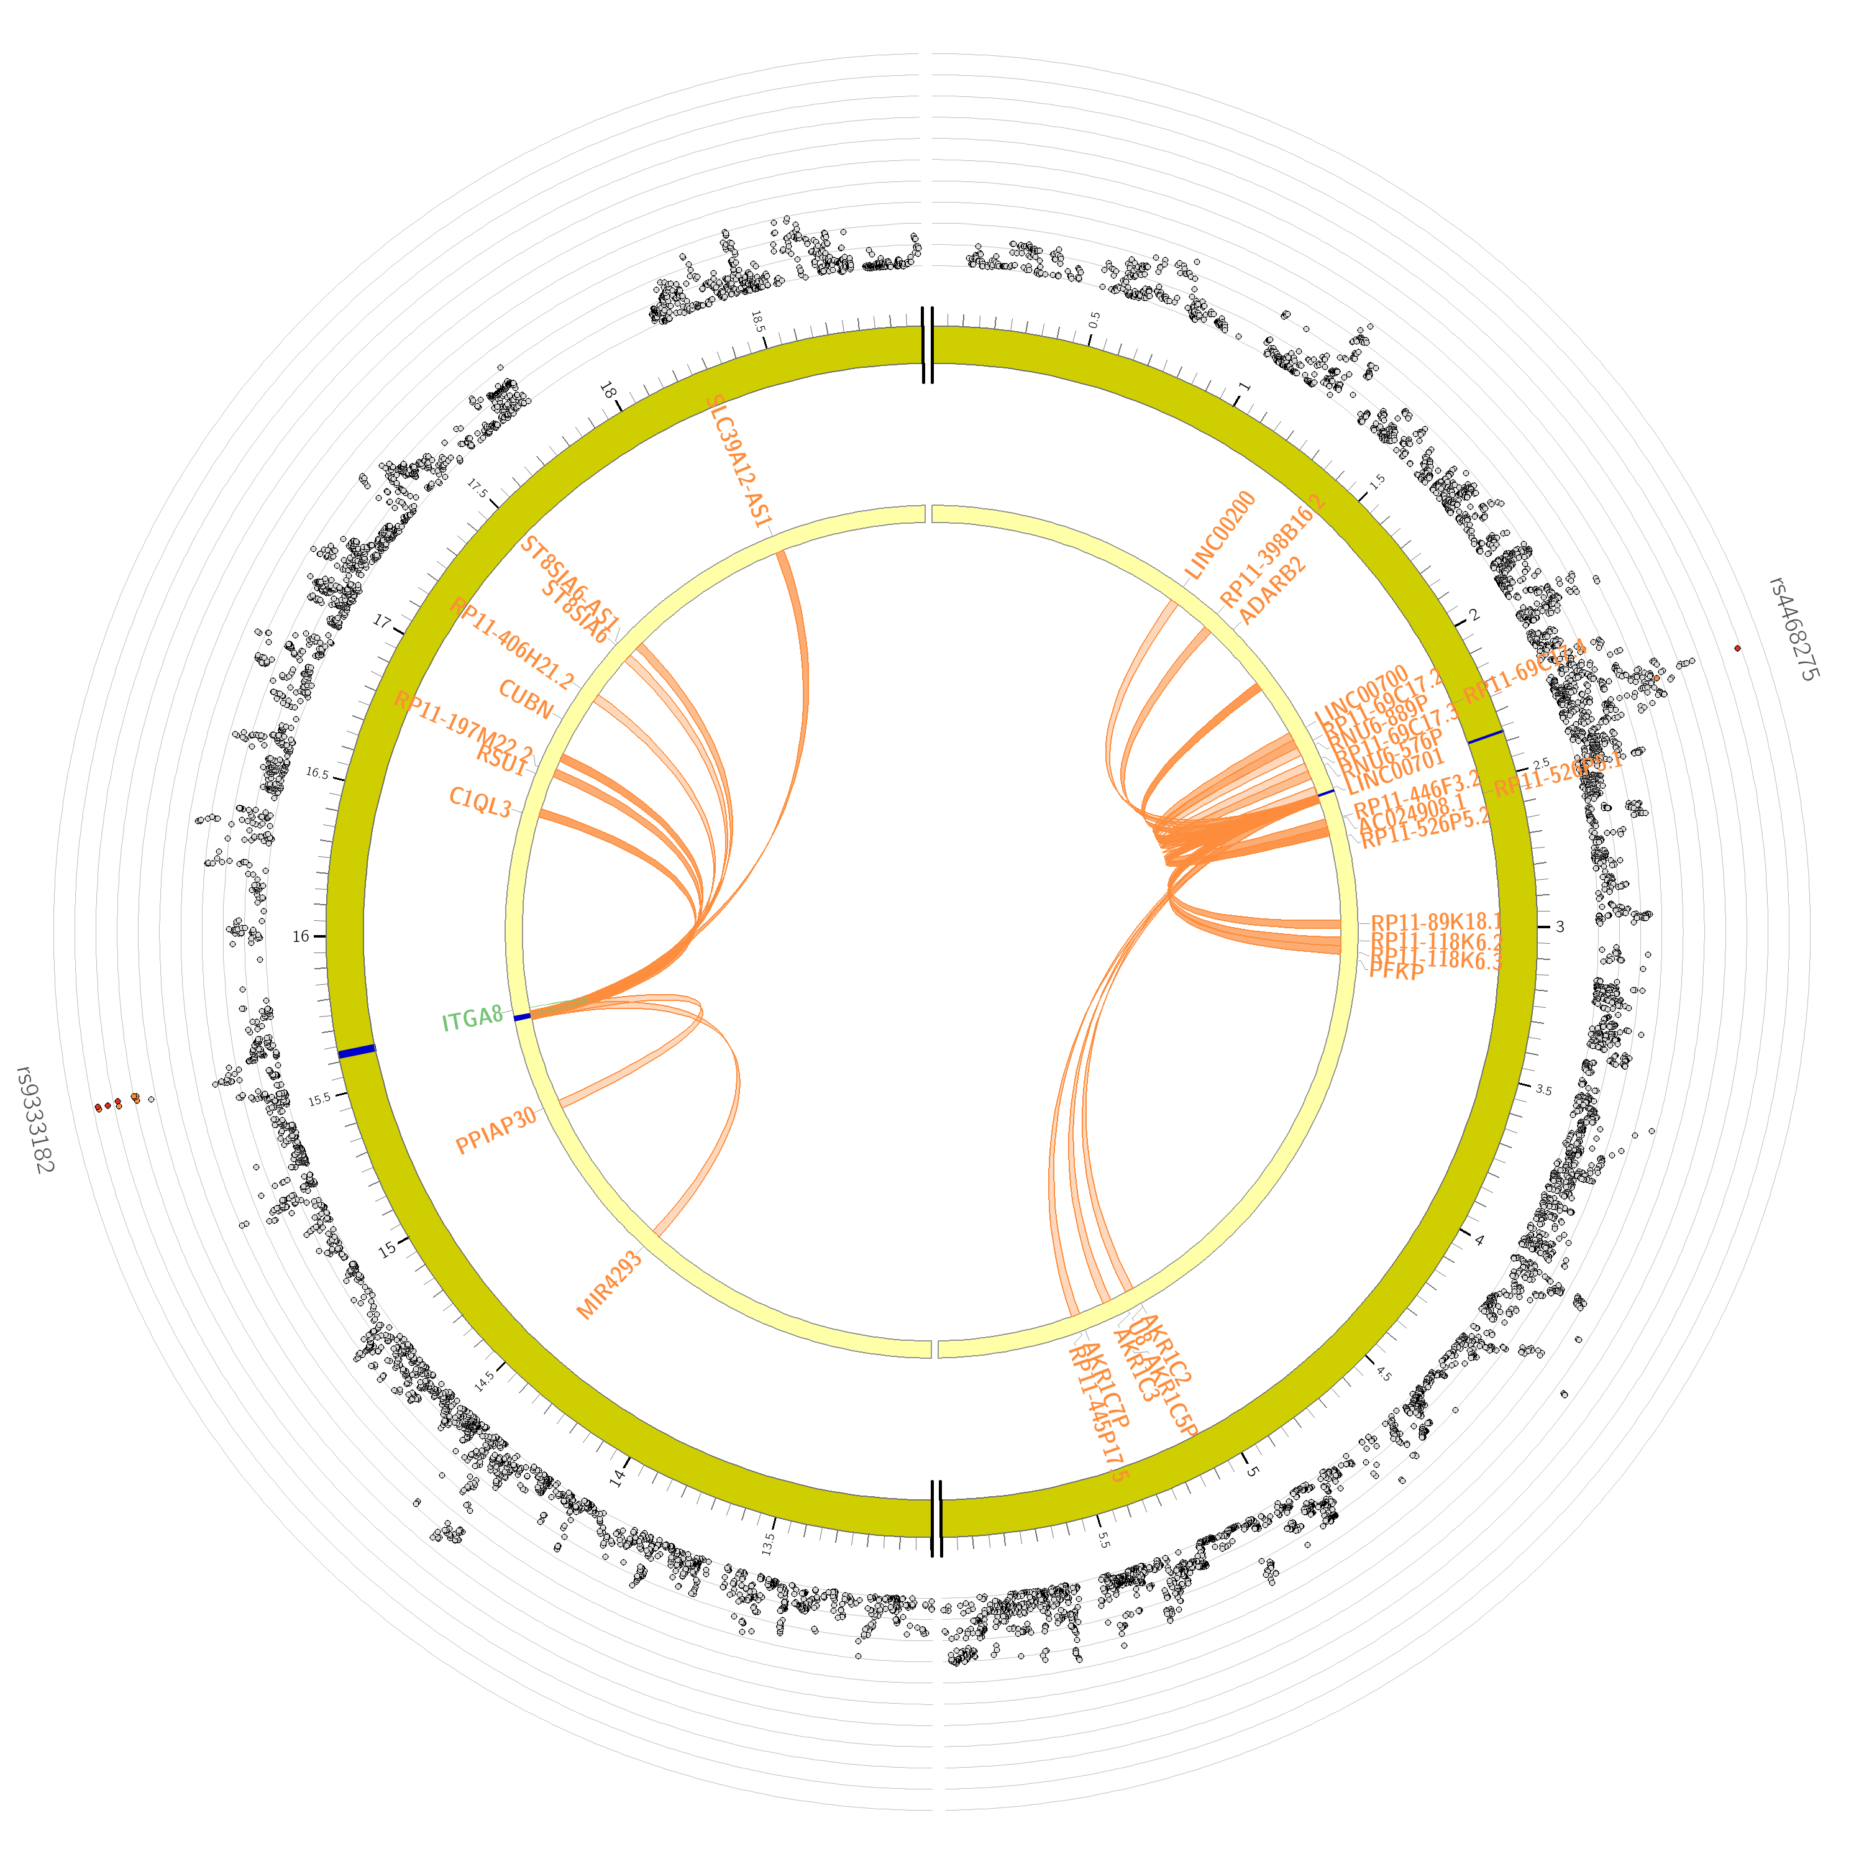
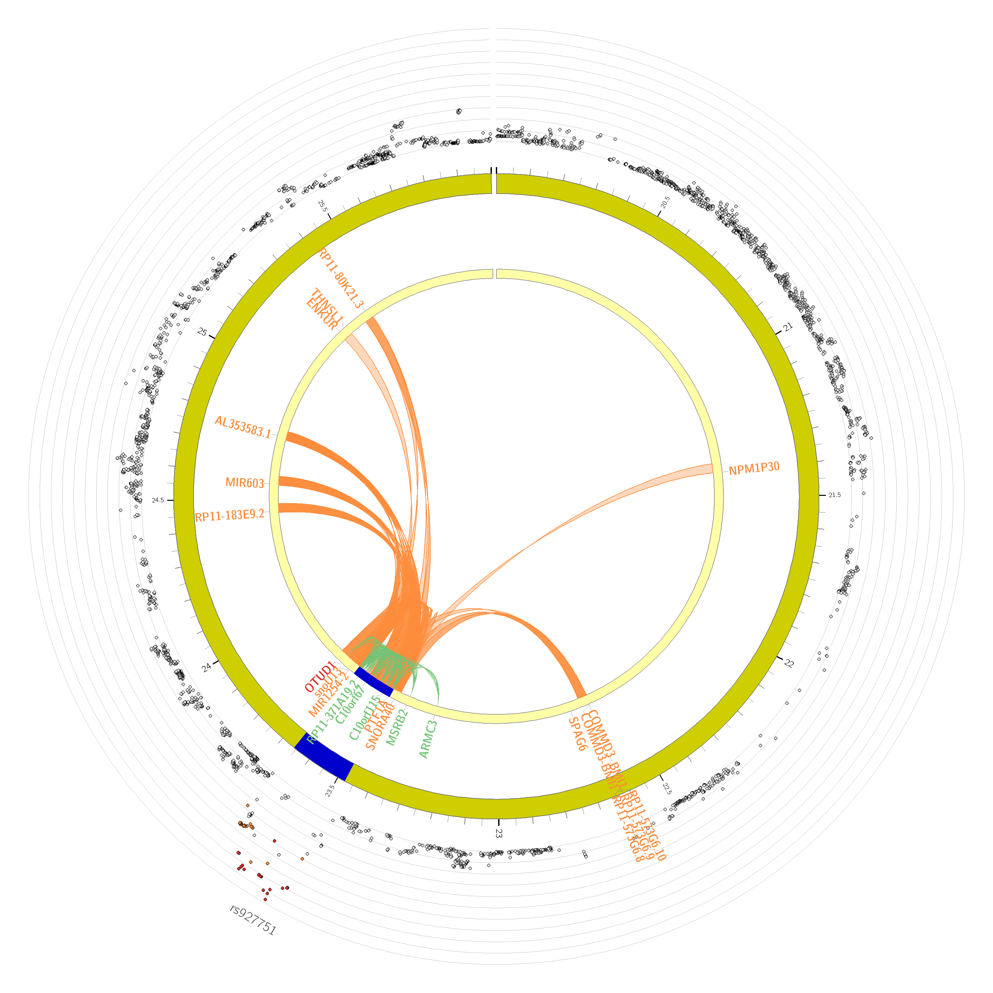
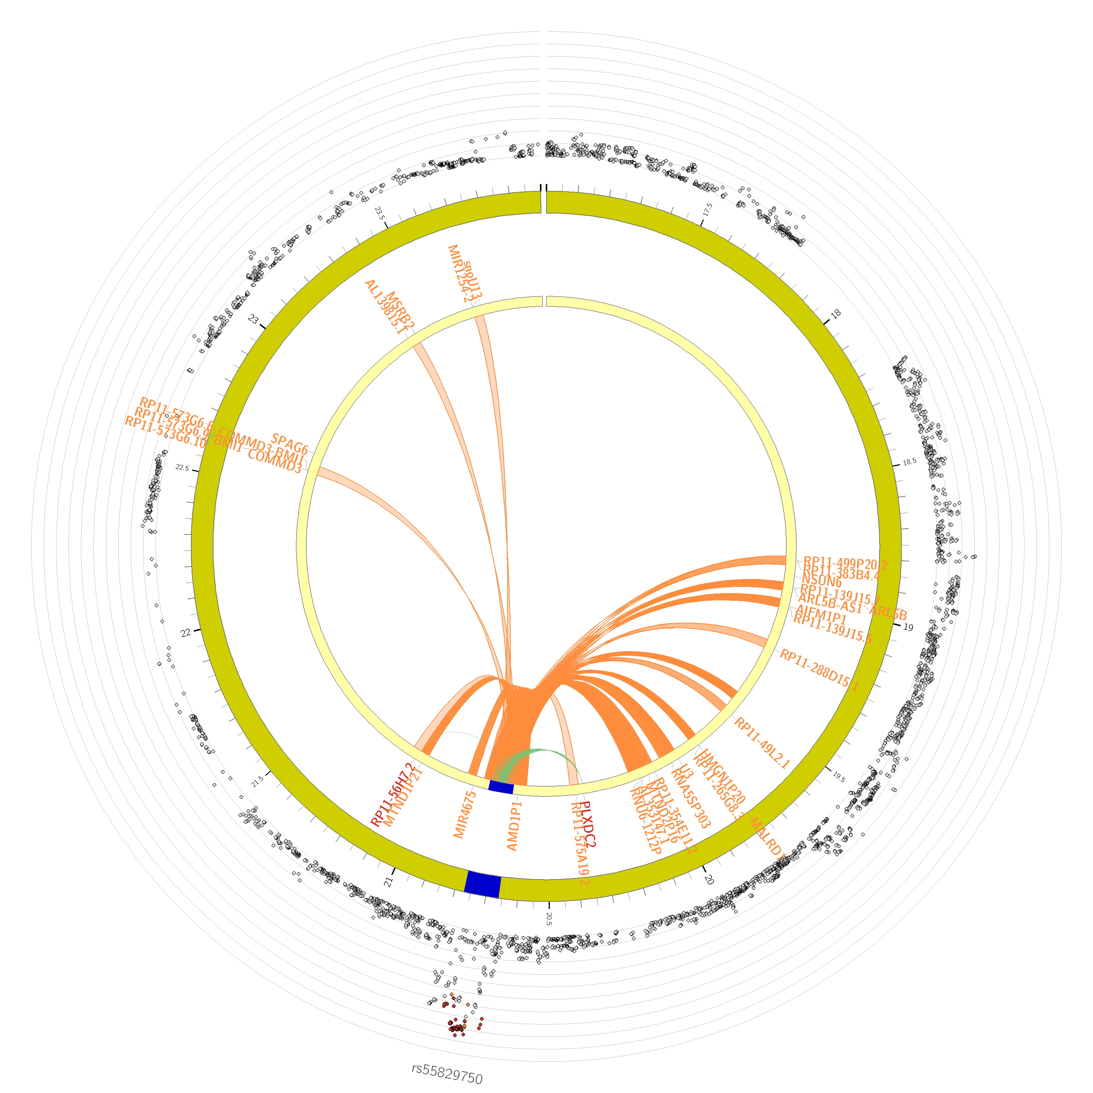
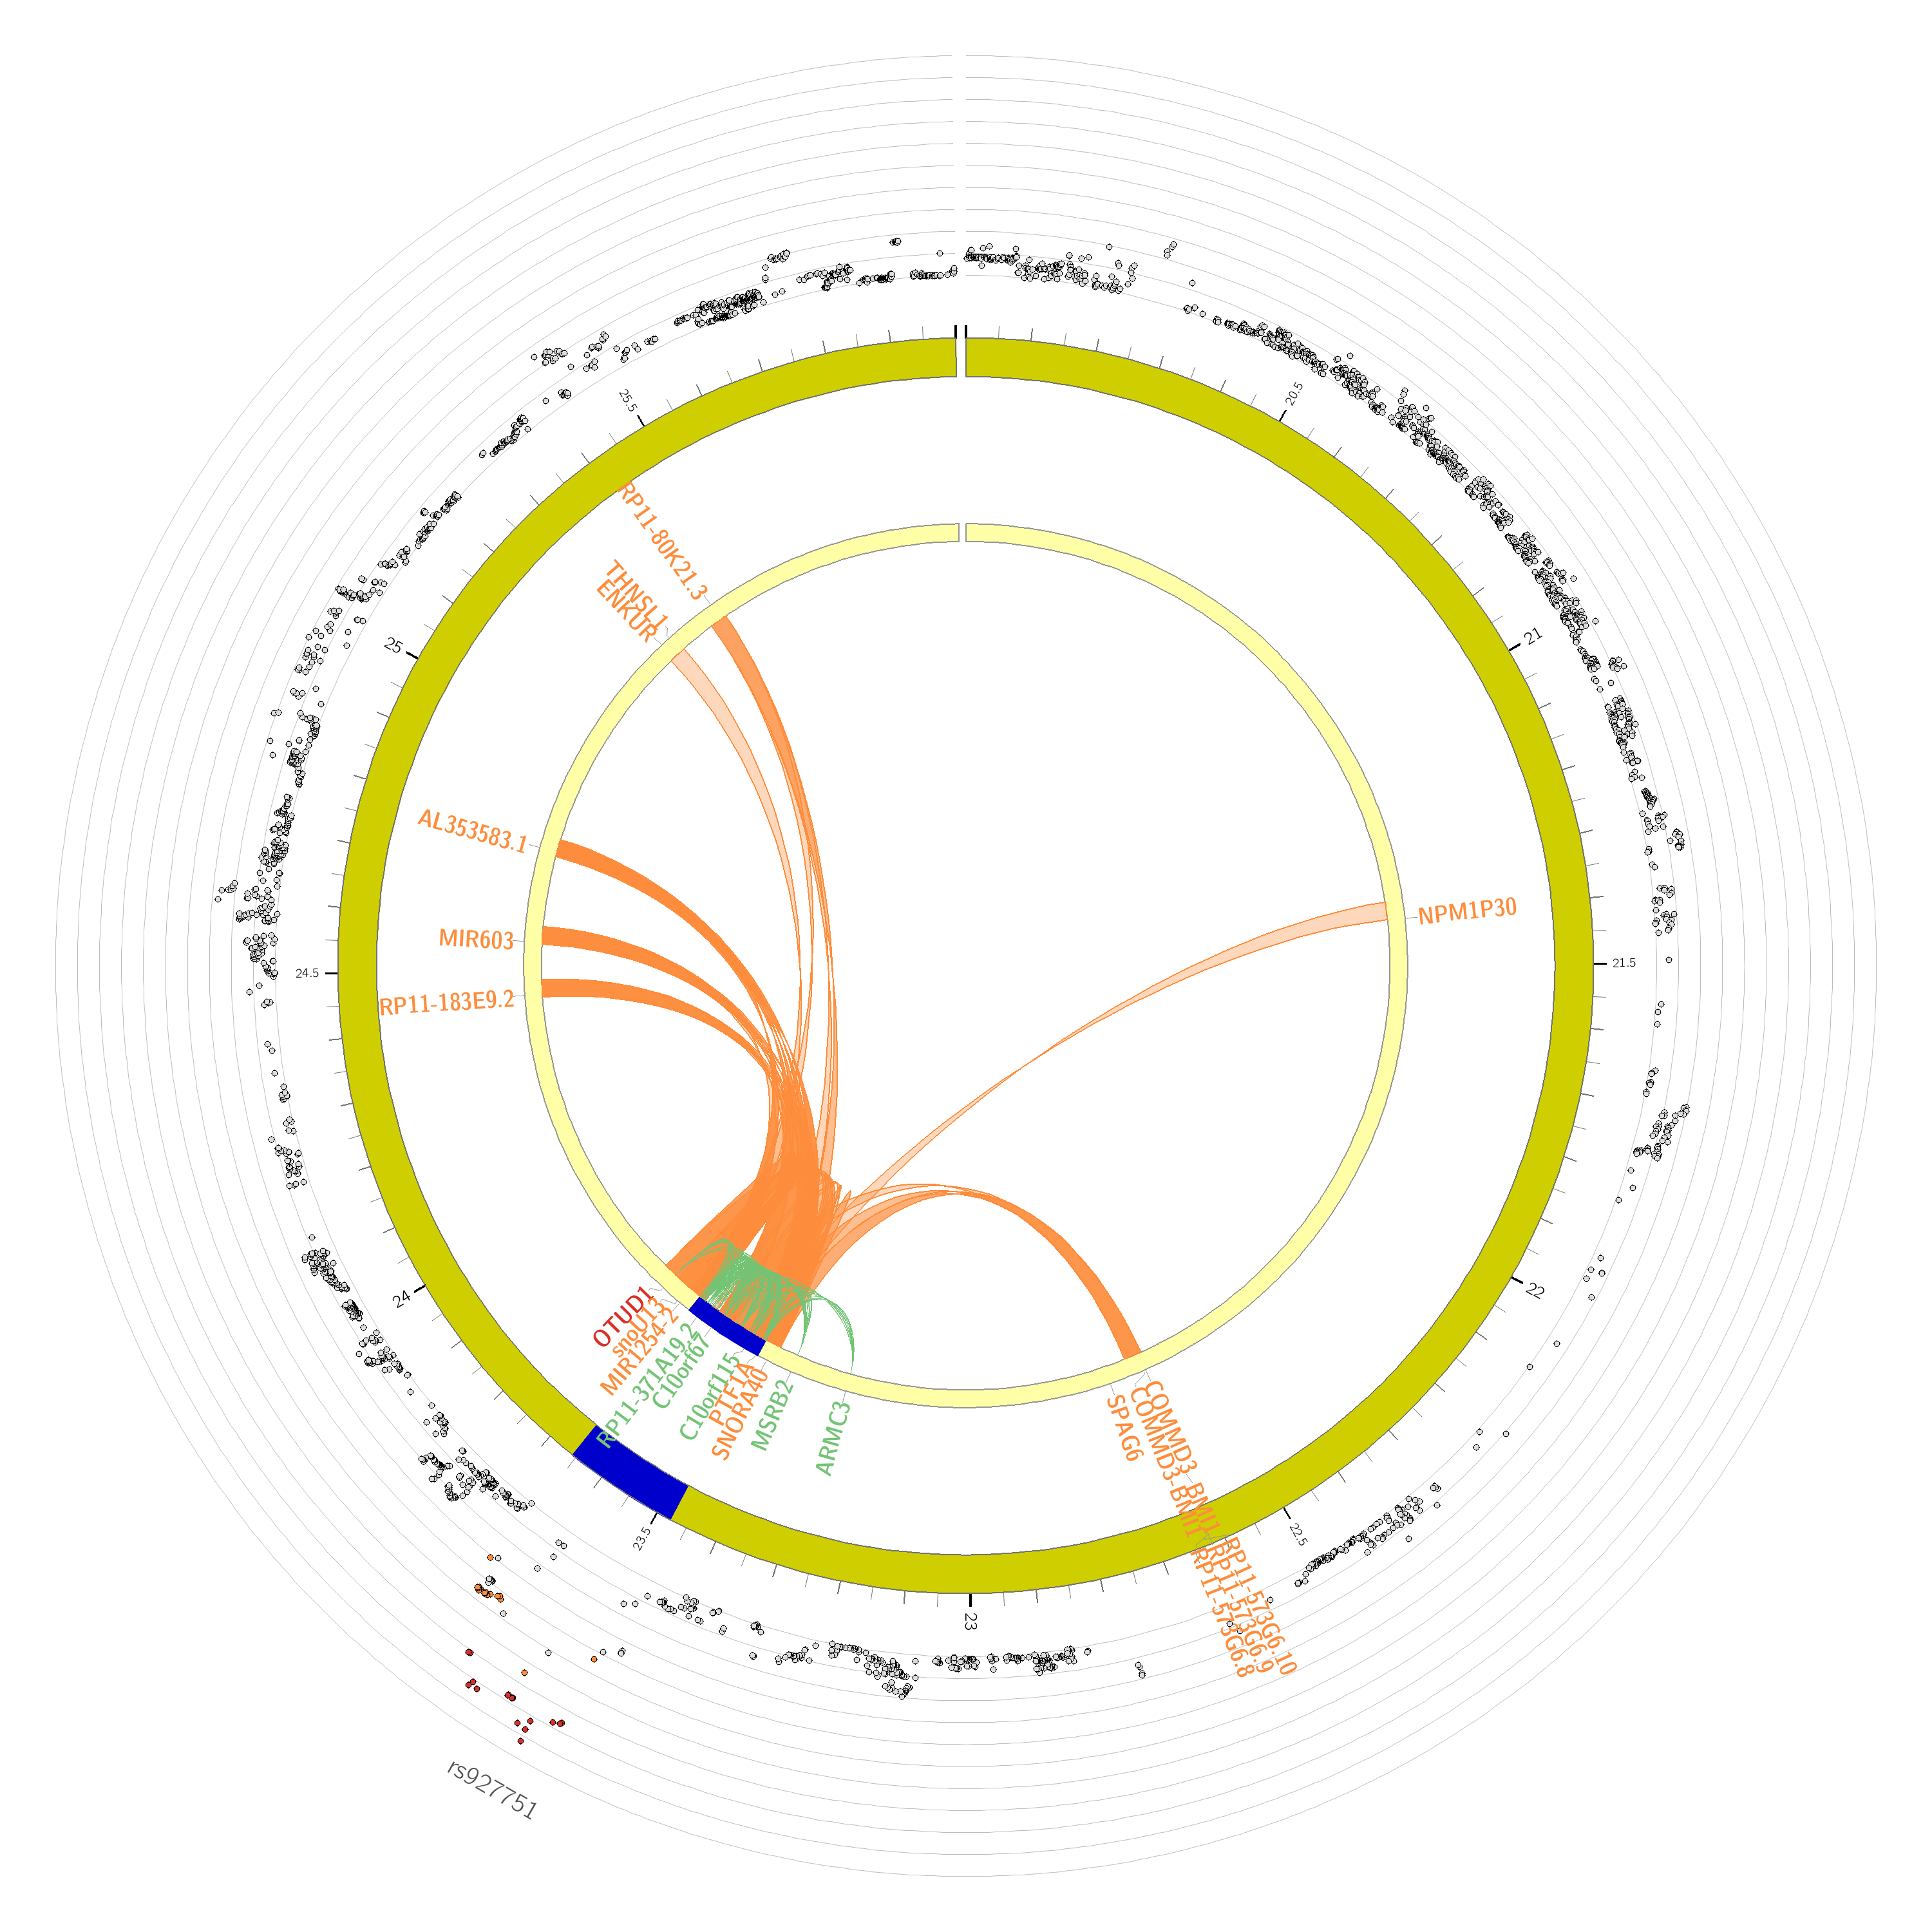
IBS
DED
DEP
GWAS
MTAG

Slide 13
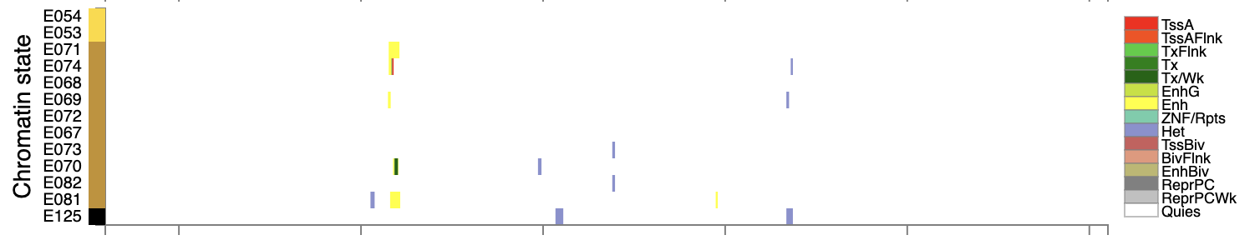
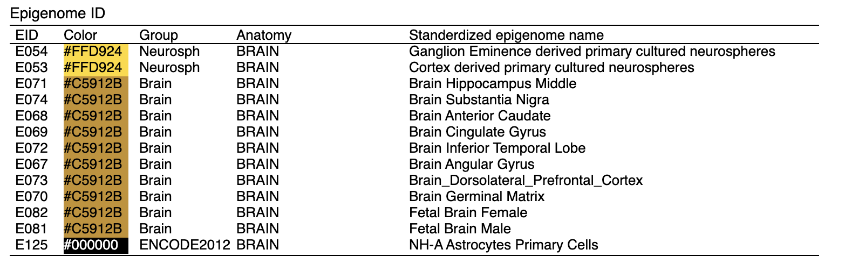
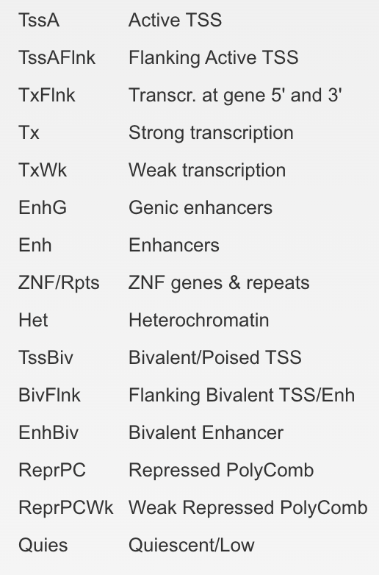
*¹transcriptional start site, TSS *²only brain-related epigenome IDs are displayed here

Slide 14
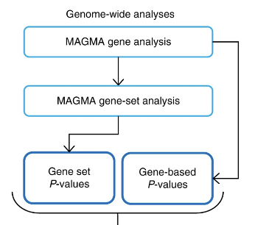
MAGMA
SNPs mapped to protein-coding genes
multiple linear regression gene-based P & LD
MSigDB v7.0 gene sets (last updated 2019), including curated gene sets 5500, GO 9996
from 9 data sources: BioCarta, KEGG, Pathway Interaction Db, Reactome, SigmaAldrich, Signaling Gateway, SuperArray SABiosciences, WikiPathways
competitive model
gene-set based SE, beta, p
–
BrainSpan 29 ages
BrainSpan 11 developmental stages
GTEx v6 – v8

Slide 15
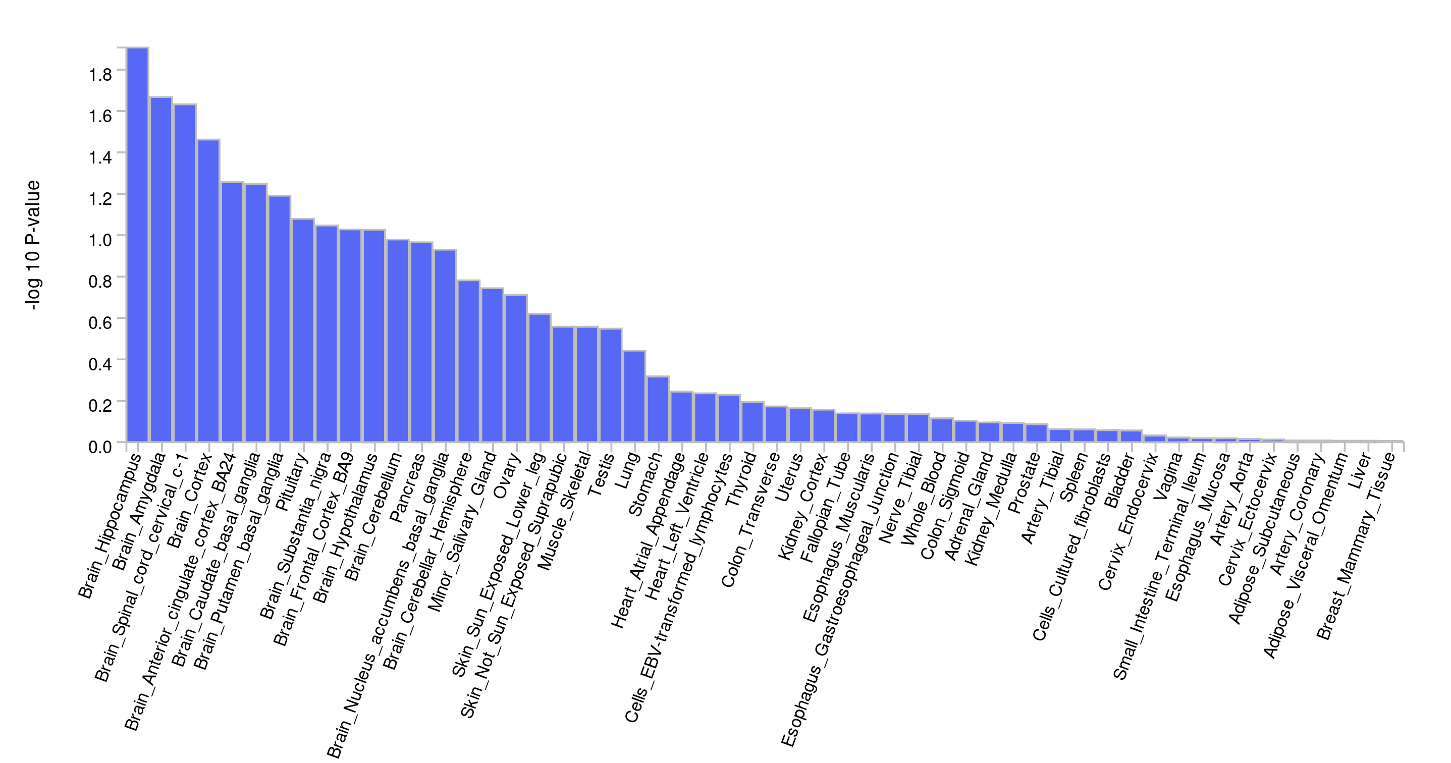
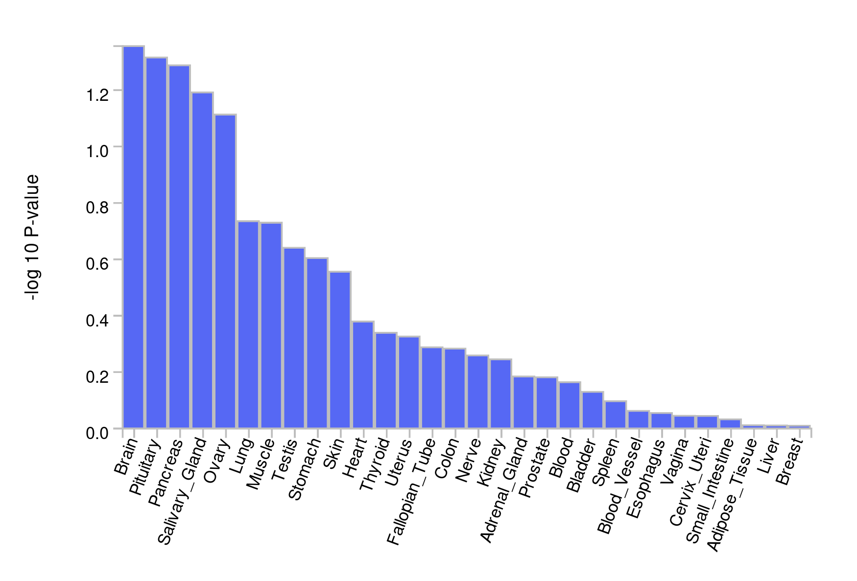
GTEx v8 tissue expression
Genotype-Tissue Expression Consortium v8 (doi: 10.1126/science.aaz1776)
RNA-seq data from 838 donors, with 85.3% European American / 12.3% African American
*red line represents p<0.05

Slide 16
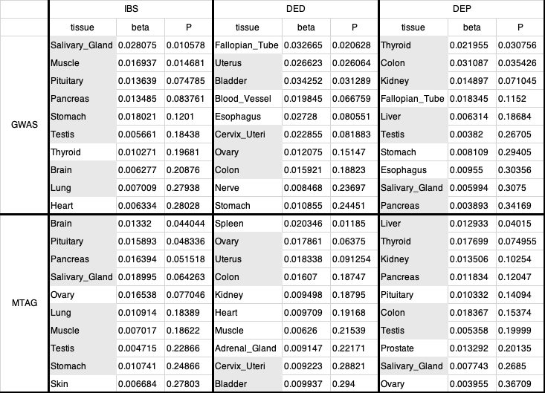
GTEx v8 30 general tissue expression

Slide 17
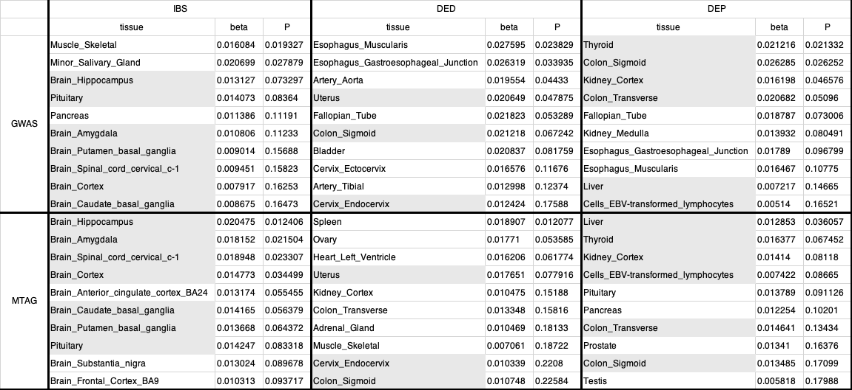
GTEx v8 53 specific tissue expression

Slide 18
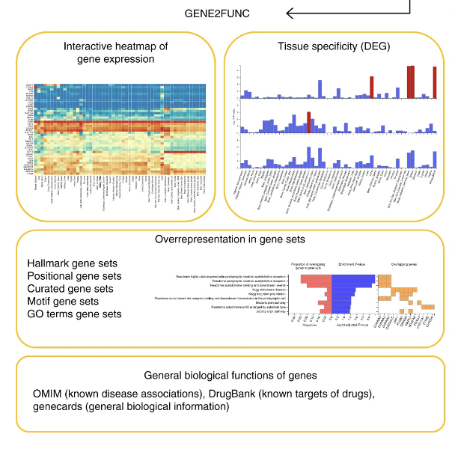
GENE2FUNC
differentially expressed gene (DEG)
two-sided t-test log₂(normalized expression val)
test correction Benjamini-Hochberg (FDR)
p < 0.05 & absolute log fold change > 0.58
–
OMIM, Uniprot, Drugbank
–
scRNA seq data cell type specificity

Slide 19
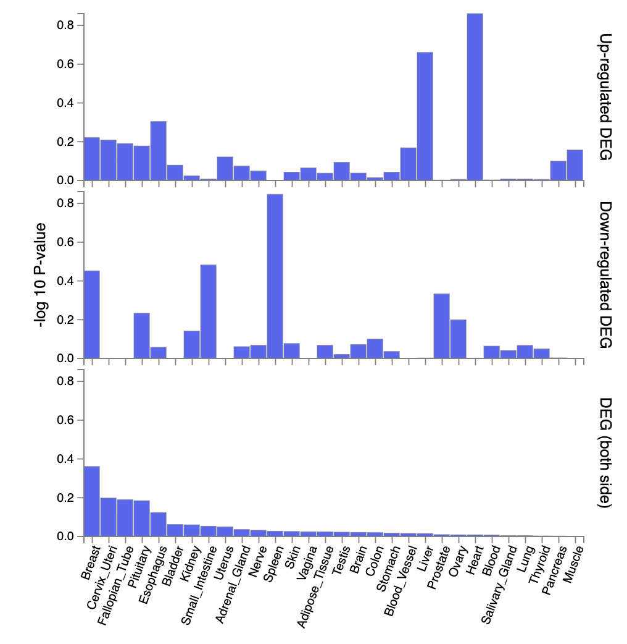
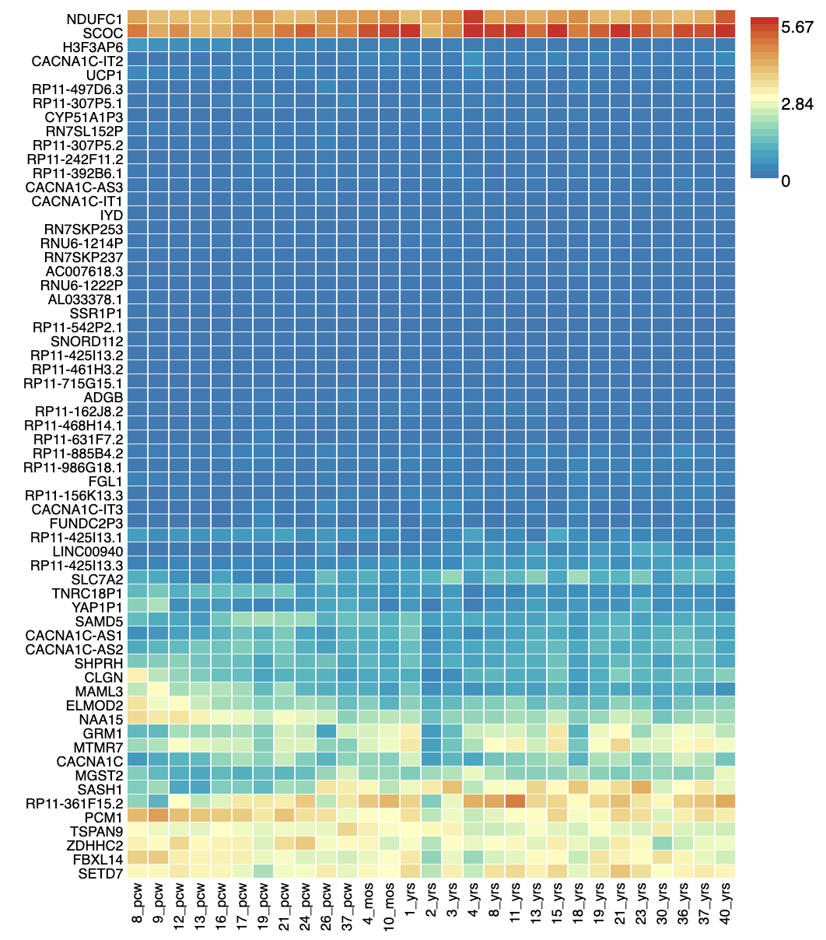
GTEx v8 30 general tissue
BrainSpan 29

Slide 20
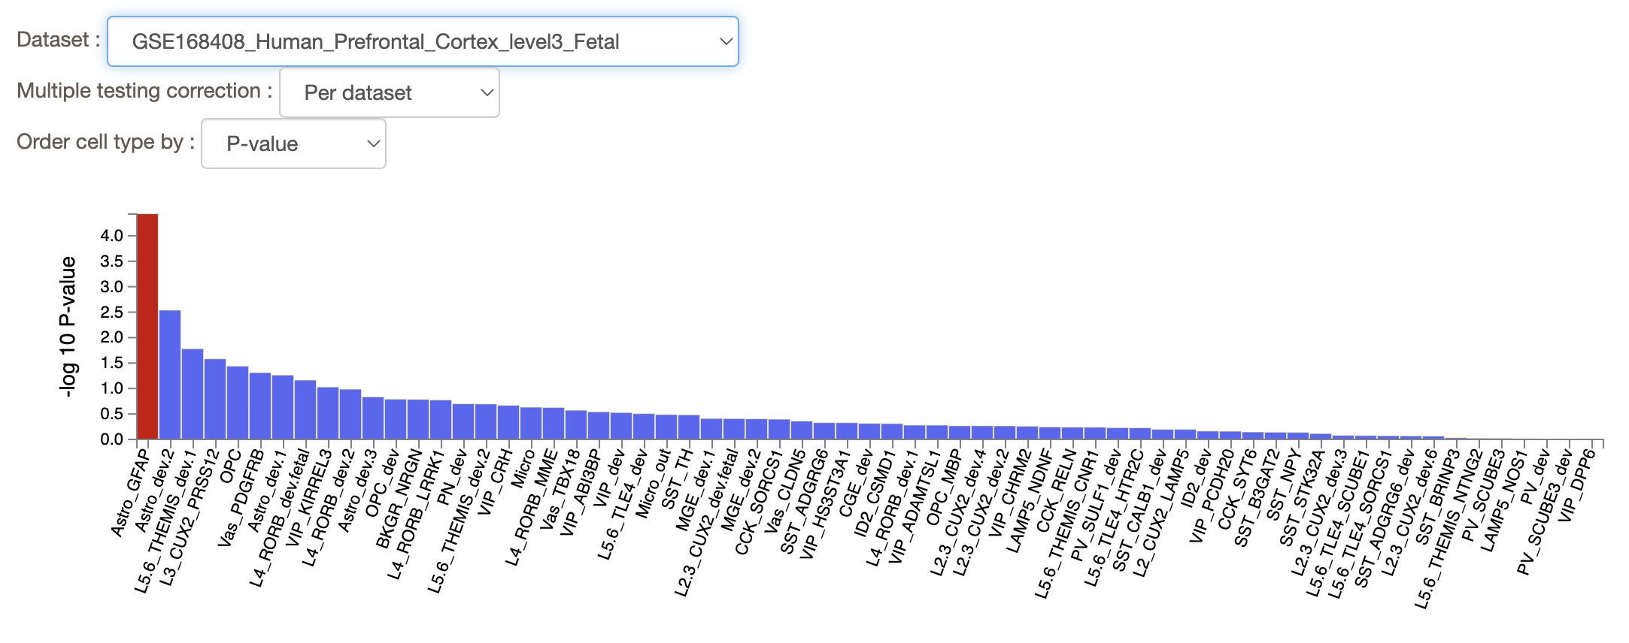

Slide 21
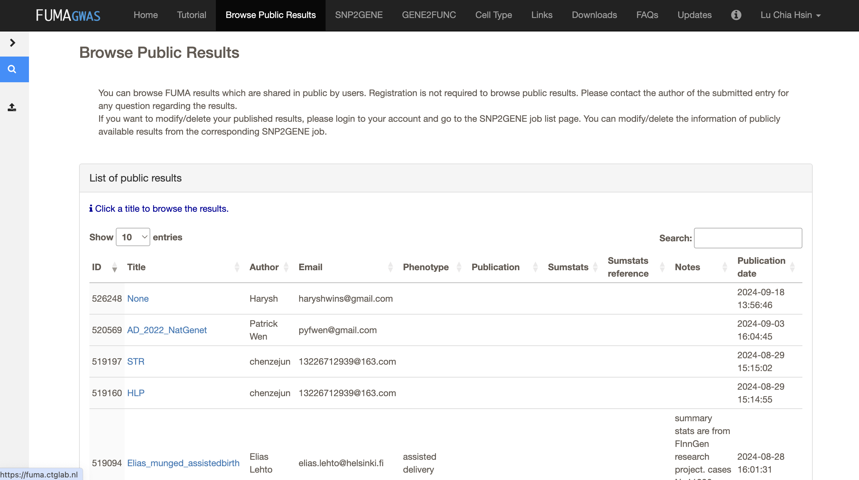

Slide 22
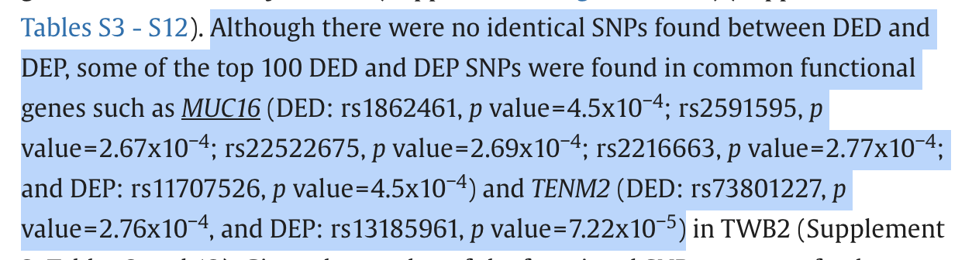
Todo
find other tissue-enrichment data sources, possibly starting from RegulomeDB
STRING, cytoscape…
calculate r_{g} and h² with e.g. LDSC, LAVA, S-LDSC
colocalization analysis of MR results with coloc R

